Slide 1
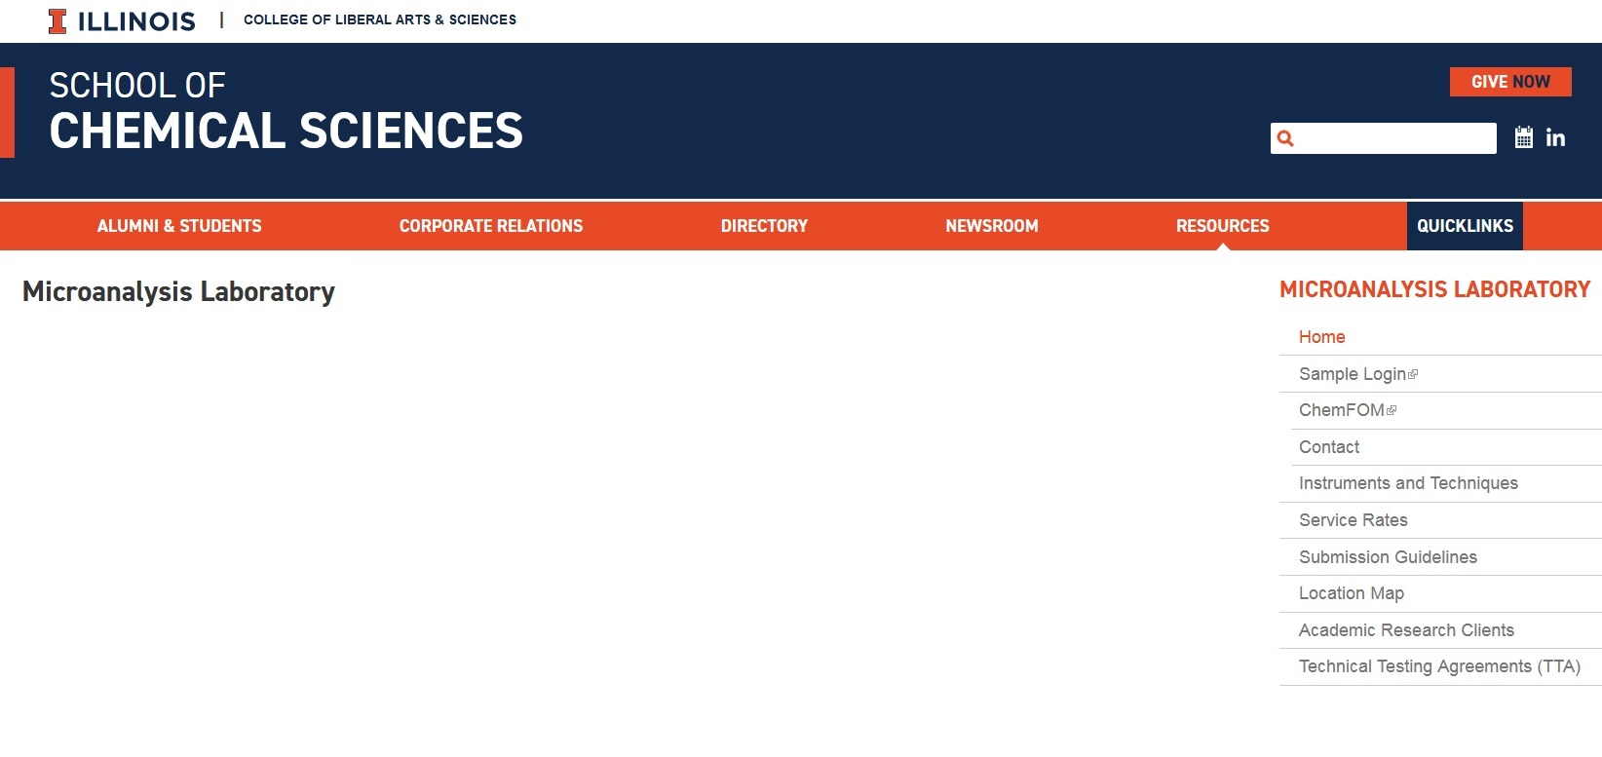
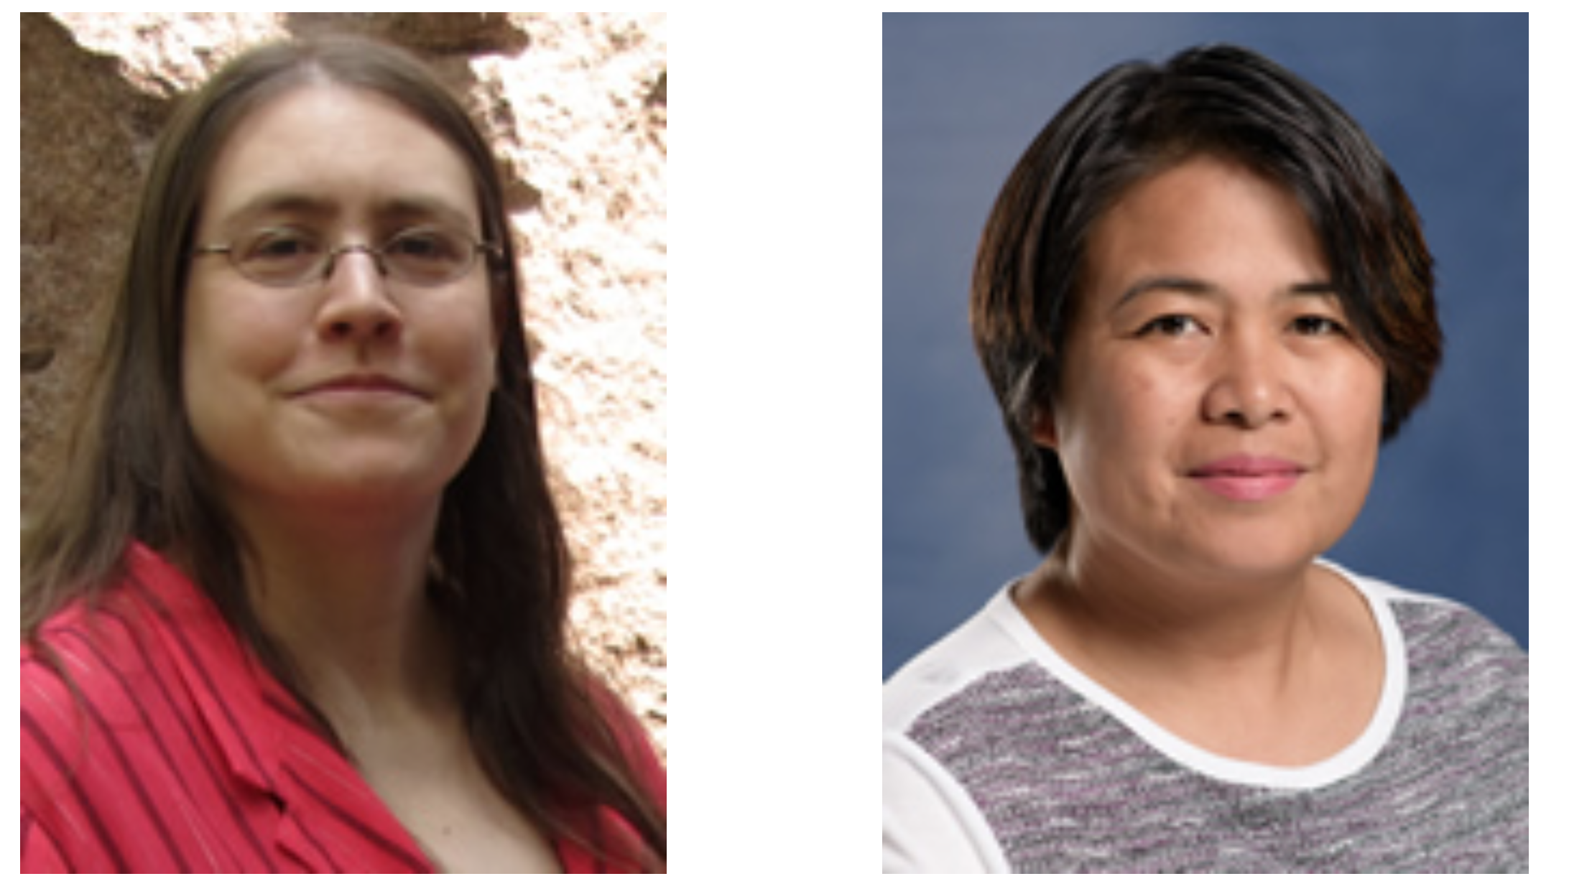
∙ Location: 47 Noyes Lab, basement
∙ Hours: 8:30am – 5pm, Monday – Friday
∙ Lab phone: (217) 333-3095
∙ Lab email: scs-microlab@illinois.edu
∙ Webpage:
https://scs.illinois.edu/resources/cores-scs-service-facilities/microanalysis-laboratory
Beth Eves
CHN Analyst, Surface Analysis Analyst and Trainer, Halide backup
(bleves@illinois.edu)
Phone: (217) 244-0496
Crislyn Lu
ICP Sample Prep Specialist,
Halide Analyst,
ITC Trainer,
ICP backup
(calu@illinois.edu)
Phone: (217) 300-4081

Slide 2

Services provided by the Microanalysis Lab
Elemental Analysis
Technician Run
Thermal Analysis
Client Run
Surface Analysis
ICP
Halides
CHN
Isothermal Titration Calorimetry (ITC)
Physisorption
Chemisorption
Thermogravimetric
Analysis (TGA)
Surface area,
pore size,
pore volume
Static/Dynamic, Temperature-Programmed analyses
Metals
Sulfur
Phosphorous
Differential Scanning Calorimetry (DSC)
All of our elemental analysis techniques are destructive.
All results, unless noted otherwise, will be reported as % by weight.
(ICP can also be ppm or ppb; Halides can also be ppm.)

Slide 3
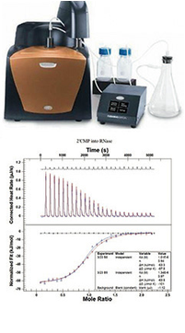
Thermal Analysis – Client run
Please contact the appropriate lab technician to get trained in any of these instruments.
Isothermal Titration Calorimeter (VP-ITC) – Measuring heat generated or absorbed in liquid samples as a result of mixing two or more reactants. (Note: Liquid samples only.)
Thermogravimetric Analyzer (TGA) – Measuring the sample weight changes over a given temperature and pressure range under specific environmental conditions. (NOTE: No corrosive gases can be used.)
Differential Scanning Calorimeter (DSC-Diamond) – Measuring the amount of energy (heat) absorbed or released by a sample as it is heated, cooled or held at a constant (isothermal) temperature. This instrument is best used for studies at temperatures of 400°C and lower.
ITC
TGA
DSC

Slide 4
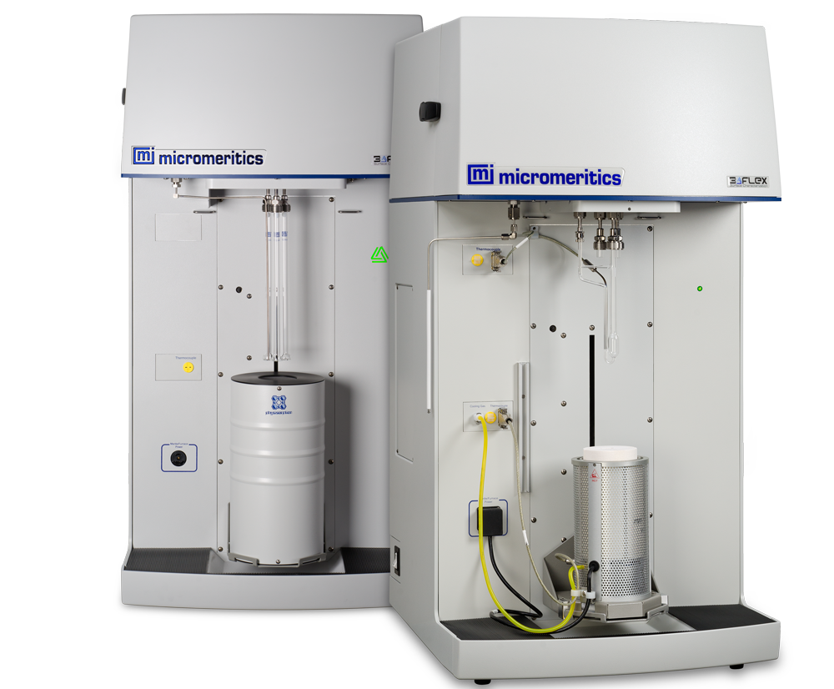
Surface Analysis – Client and Tech-run
Micromeritics 3Flex analyzer and SmartVac degasser
Technician run or client run after training
Solid samples only.
Gas selections should be discussed with the technician.
Physisorption – weak interactions occur between the adsorbate and the solid surface. Reversible.
  surface area (BET), mesopore/micropore (pore size, pore volume)
  adsorption, desorption, isotherms, vapor adsorption
Chemisorption – strong interactions/bondings occur between the adsorbate and the solid surface. Non-reversible.
  static/dynamic, temperature-programmed analyses
  heat of adsorption/desorption
3Flex analyzer
(Physi config, Chemi config)
SmartVac degasser
Notes:
The SmartVac can degas 6 samples at a time, each with an individual degassing program, independent of the other ports.
The 3Flex can run up to 3 samples at a time for physisorption, each with their own individual analysis set-up.
Can run 1 chemisorption sample at a time.

Slide 5
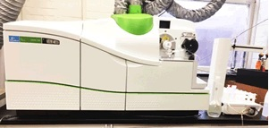
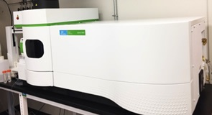
Elemental Analysis – Tech run
CHN Analysis: Exeter CE 440
Carbon, Hydrogen, Nitrogen
ICP Analysis:
All metals plus sulfur and phosphorus
PerkinElmer NexION 350D ICP-MS
Halide Analysis: Ion-Selective Electrodes
Cl, Br, F, I
Solids are first combusted via Schöniger oxidation flask method.
PerkinElmer Optima 8300 ICP-OES

Slide 6
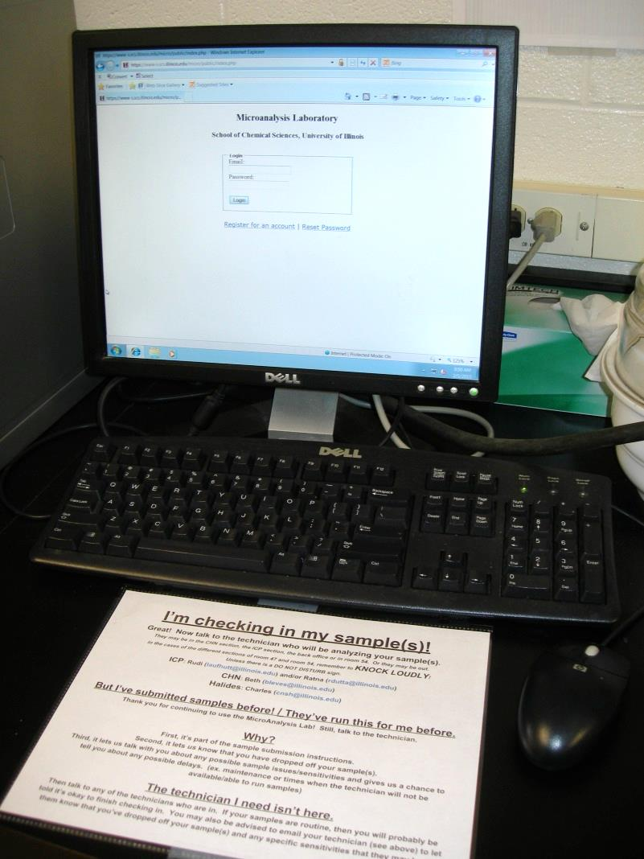
Getting Started on Elemental Analysis
Note: If you have problems with any of these procedures, talk with one of the technicians!
Make an account
Create submission forms (Small Molecule, usually) at any computer that can access the Sample Login page.
    Name for your samples, what technique(s)/elements wanted, theoreticals or estimated theoreticals, list of sensitivities (moisture, light, air, acid) or precautions (volatile, toxic, explosive), how should it be stored.
Bring your samples to the lab, check in the submission form (which can ONLY be done at our computer) and put your samples in the correct location.
The last thing before you leave the Micro Lab: talk with the technician who will be performing your analysis or, if they are not there, talk with whatever technician is available.
Ex: Compound DVA-165, for S, CHN and Br. Three vials, labelled A, B and C.
Sample name: DVA-165
Checked ICP (element sulfur), CHN and Halide (element Br)
In comment section: “Vial A is for ICP, B for CHN and C for halide.”
Ex: 10 compounds, 1-10, for ICP (S, Na and Hg)
Sample names: 1, 2, 3, 4, 5, 6, 7, 8, 9, 10 using the Multiple Samples button
Checked ICP, making sure to check for S, Na and Hg analysis.
Ex: 2 different compounds, KS-1 and KS-2, CHN, via the air-sensitive protocol, 4 jars total
2 separate submission forms, because the theoreticals are not the same.
Each submission form has CHN checked.
Each form has the 2 air-sensitive jar names for that compound listed in the Cap# section.
Notes:
: Individual accounts can be made from the check-in computer in our lab or from the Sample Login webpage.
If you just drop off samples without making a submission form, we will have no idea whose samples they are or what analyses they are for.
If you do have a submission form, but you didn’t check the samples into the system, they will not be run until they are checked in. Checked-in submission forms have a Work Order # in your account.

Slide 7
Air-sensitive, moisture-sensitive or unstable sample protocols:
If your elemental analysis sample is sensitive to being exposed to air, to humidity in the air or is unstable:
Pick up the protocol jars and talk to the technician to schedule your analysis.
If you don’t schedule ahead of time when your samples will be run, the technique may not be available, someone else’s samples may be ahead of yours, the instrument may be undergoing maintenance, etc. Your samples may sit and degrade.
In the drawer under the sample counter:
Red jars: Tin capsules for CHN analysis, Fluorine analysis and Aluminum analysis via ICP.
Blue jars: Aluminum capsules for all other ICP analyses and all other halide analyses.
Talk to the technician for how much sample you need to put into each capsule for the requested technique, along with additional information.
Clients will fill the capsules, close/seal the tops and then deliver the jars back to the lab at the scheduled time for analysis.
Notes:
If there are not enough jars available, ask a technician and we will fill some for you!
Make sure that there is no excess compound on the outside of the capsule. The better the capsule is sealed, the less exposure there will be to the compound inside while the capsule is being weighed and then analyzed.

Slide 8
How much sample is needed?
  Depends on the concentration of elements to be detected. Samples can be solids, liquids, oils, goo or aqueous solutions.
  Recoverable means the amount of sample that can be removed accurately and without contamination from your vial. It does not mean the least amount of sample in your vial.
  Containers should be clean and all surfaces inert to your sample. Sample that needs to be scraped hard off of plastic conical vial walls may introduce contamination. If your sample is a thin dried film, recovery from the bottom or sides of a 20mL scintillation vial or from the bottom of a 15mL conical centrifuge tube will be impractical.
Technique | Amount | Notes
CHN | 5 – 10mg recoverable material | Duplicate runs will be performed automatically if enough sample is provided. NO aqueous samples/solutions will be accepted for CHN analysis.
Halides | 5 – 15mg recoverable material | Aqueous solutions: Talk to the analyst, as the theoretical wt-% of the element and the amount of solution available will determine whether we can run the sample or not, based on equipment, calibration ranges and limits of detection.
ICP | 5 – 10mg recoverable material Aqueous solutions, predissolved: 10mL/element | Aqueous solutions will be acidified prior to analysis. Solid samples and liquid samples with organic constituents will be digested and diluted prior to ICP analysis.
Notes:
Trace analysis will often need more sample; talk to the analyst. If you do not have enough sample, talk with the analyst.
It is helpful to have a different vial of sample for each technique you want performed. Especially if your samples have any air or moisture sensitivities. It is okay if this is not possible.
Why no aqueous solutions for CHN? Because all you can see is H from the water. Your solution would need to be very very concentrated in the water solution to see anything else but H from water.

Slide 9
Results and Turn-Around Times
All results, unless noted otherwise, will be reported as % by weight.
Your results will be sent to you via email to the email address your account is made under.
Depending on the status of the previous day’s runs, the sample que and whether instrument maintenance is needed, turnaround time for results is usually:
    CHN analysis: 2-3 business days.
  If 24-hour CHN turnaround is needed, please talk to Elizabeth Eves (bleves@illinois.edu).
    ICP analysis: 3-10 business days
    Halide analysis: 3-5 business days
These times will be longer if there are instrumental problems, maintenance or if the staff is reduced due to sickness, vacation or meetings. Samples are run on a first-in, first-out basis. If you will need your results by a certain date or need rush or priority treatment, talk to the technician to see if this is possible.
Notes:
If you would like any leftover samples back, please indicate that in the submission form Comment section.
We would appreciate it if you acknowledge the Microanalysis Lab in your publications and presentations that rely on data obtained by the technicians in our lab or on the student-run instruments. If you have wording, instrument or technique questions, please feel free to ask! And please let us know when your papers mention us so we can update our list for grant time.

Slide 10
Questions?

