Slide 1
High-Throughput Screening and the HTS Facility
Chen Zhang
HTSF Director

Slide 2
What is HTS?
Wanted: Antagonist/ binder/ inhibitor/ antibody/etc., for your macromolecule of interest
Problem: No known molecule; Not enough information for rational design; de novo design not successful
Solution: Use robotic system to screen large collections of compound/ siRNA/ peptide/ antibody libraries to identify hits
Notes:
To develop potential drug for diseases, or study biological mechanisms, people want to find.

Slide 3
HTS Applications
Enzymes
Micro RNAs
DNA/RNA-protein interaction
Protein-protein interaction
Receptor-ligand binding
Bacteria/ mammalian cell growth, gene expression
Cell differentiation and signaling pathway

Slide 4
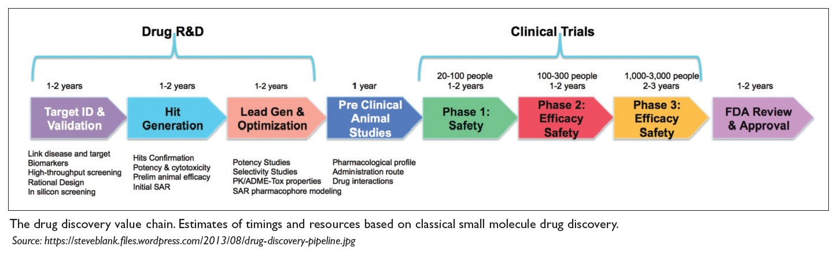
HTS in Drug Discovery

Slide 5
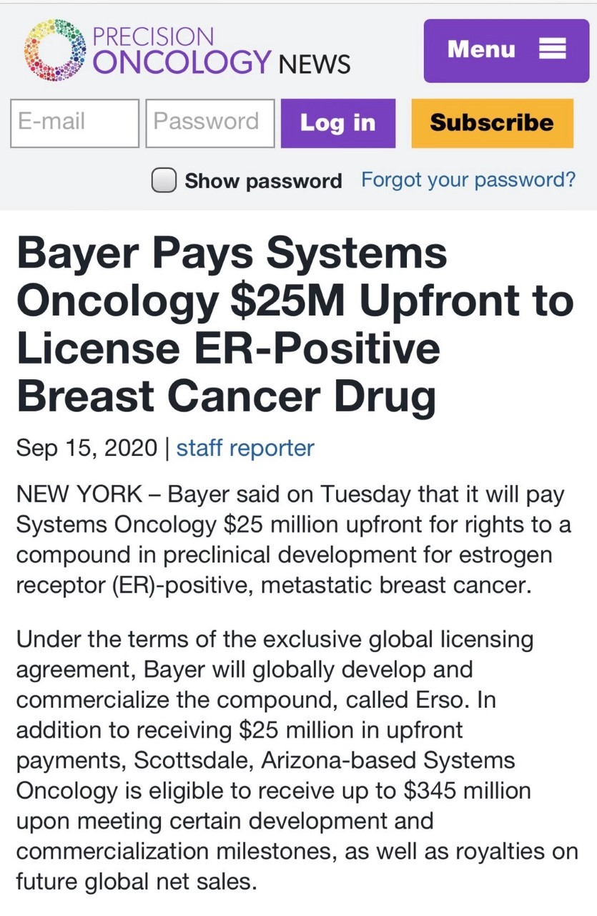

Slide 6
HTS Facility
HTSF can help with all aspects of:
- Assay development/optimization
- High-throughput screening
- Data analysis/interpretation
Secondary experiments
Follow-up assays
“Free” consultation to initiate new projects
- On campus, external academic and industrial users

Slide 7
Assay Design and Optimization
Appropriate controls
Sufficient assay quality
Compatible with the robotic system instrumentation
Stability and reproducibility
Reagent costs

Slide 8
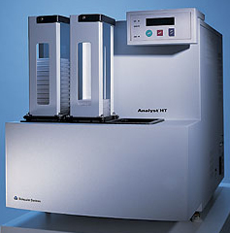
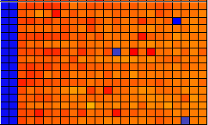
Plate Readers: Analyst HT
Potential Hits
Luminescence
Fluorescence
Negative Controls
Positive Controls

Slide 9
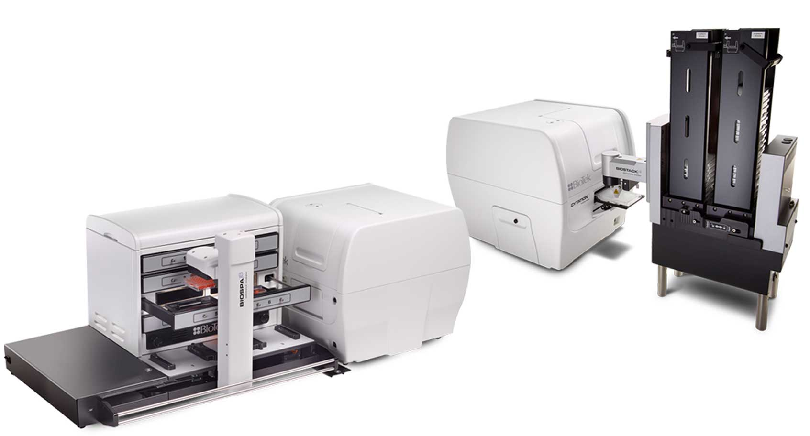
Plate Readers: Cytation 5
Temperature/CO2 controlled
Automated long term detection provided by BioSpa incubator

Slide 10
Plate Reader
Monochromator and filter based
Absorbance (230 - 999 nm, 1 nm increment)
Fluorescence intensity (250 - 700 nm)
Spectrum Scan
Fluorescence polarization (anisotropy)
Fluorescence resonance energy transfer (FRET)
Time-resolved fluorescence (TR) and TR-FRET
Luminescence
Bioluminescence resonance energy transfer (BRET)
Alpha Screen and AlphaLISA
Convenient 16 sample direct protein/DNA/RNA measure (only 2 ul needed)
Dual reagent injection (5-1000 µL) for fast kinetics
Temperature and CO2 control
Equipped with plate stacker for batch process

Slide 11
Imaging Reader
Bright field, phase contrast, fluorescence imaging
Objectives: 4X, 10X, 20X, 40X
Z-stacking, montage, time-lapse
Filters: DAPI, CFP, GFP, YFP, RFP, Texas Red, CY5, CFP-YFP FRET, Acridine Orange, Propidium Iodide (up to 4 at a time)
Laser autofocus (fast and less photo-bleaching), image-based autofocus
Dual injectors for fast kinetics imaging such as calcium efflux
6-1536 well plates, slides, petri-dish, other vessels possible with adaptor
Temperature and CO2 control for live imaging
Automated long term imaging (ex. Image every hour for 3 days)
User-friendly image processing and data analysis software

Slide 12
Image-based Detection
Images Source From BioTek

Slide 13
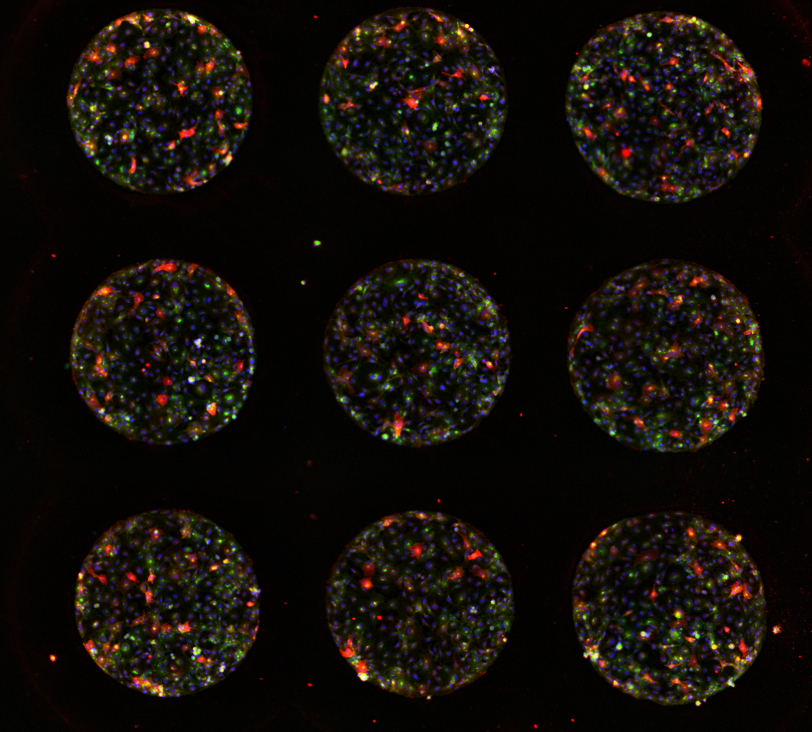
Sample Images
Bacterial colonies size
van de Donk Lab in Chemistry
Cell stained with multiple antibodies
Underhill lab in Bioengineering

Slide 14
Screening can be done in collaboration with other facilities
MNR
MS
Surface Plasmon Resonance (SPR)
Flow-cytometry
DNA-encoded library (sequencing)
CRISPR-based library (target identification or mechanism of action)

Slide 15
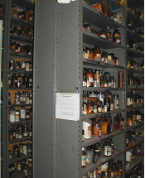
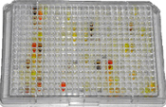
Compound Libraries
Compound collections (~278,000 total):
ChemBridge Diversity ~150,000 compounds
ChemDiv Diversity ~100,000 compounds
National Cancer Institute ~10,000 compounds
Marvel Library ~10,000 compounds
HTSF House Library ~8,000 compounds
> 850
384-well plates

Slide 16
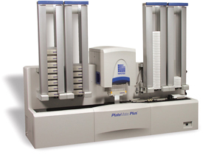
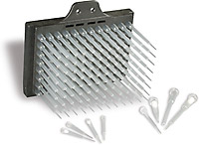
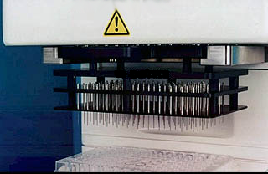
Liquid Handling
PinTransferTool
PlateMatePlus
96/384 Tips
Add reagents to whole plates
Transfer compounds from stock plates to assay plates

Slide 17
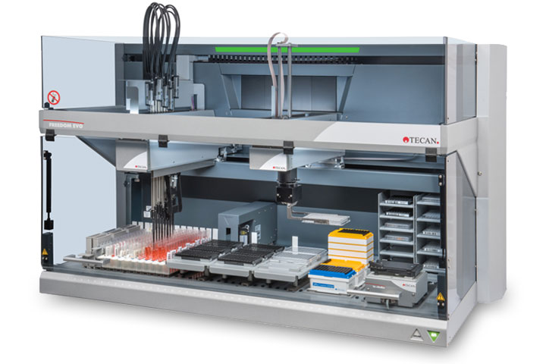
Liquid Handling
Serial dilution
Transfer from/ into individual well

Slide 18
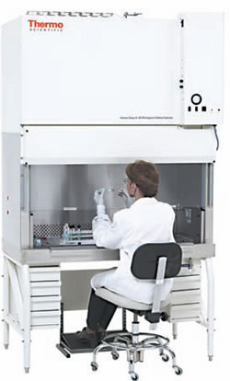
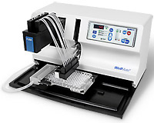
Liquid Handling in BSC
Small Sterile Liquid Dispenser
Bio-Safety Cabinet

Slide 19
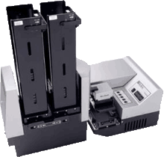
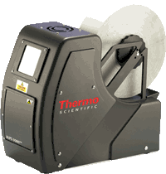
Automation Equipment
Plate Washer
Plate Sealer
ELISA assay or fixed cells wash

Slide 20
Screen Follow-ups
Data Analysis & Hits Selection
Hits Validation
Secondary Assay Validation
Potency/ Specificity
Mechanism of Action (MOA)
Structure Activity Relationship (SAR)

Slide 21
What can you do for the HTSF
Compound Submission:
Submit your compounds to the HTSF House library
Compounds will be added to screening plates
Compounds screened in numerous assays
Compounds could provide valuable research tool or new drug
Structure | University | Name | Lab | Phone Number | Email | Compound Name | Notebook number | Notebook page number | Submitted as | weight (mg) | MW
 | UIUC | Chen Zhang | HTSF | 244-4198 | czhang8@illinois.edu | PAC-1 | 1 | 192 | 10 mM DMSO stock | 120 uL | 384.41
 | UIUC | Chen Zhang | HTSF | 244-4198 | czhang8@illinois.edu | BHPI | 1 | 195 | neat | 5.8 | 285.32

Slide 22
Contact Info
www.scs.illinois.edu/htsf
https://scs.illinois.edu/resources/cores-scs-service-facilities/high-throughput-screening-facility
Chen Zhang
Lab: 361 Noyes Lab
Office: 363 Noyes Lab
217-244-4198
czhang8@illinois.edu

