Slide 1
SCS Mass Spectrometry Laboratory
Contact Information
  31 Noyes Laboratory (8:00-5:00 M-F)
  217-333-2545
  https://scs.illinois.edu/resources/cores-scs-service-facilities/mass-spectrometry-lab
  Furong Sun (frs@illinois.edu)
Staff
Furong Sun, Director
Haijun Yao, Spectrometrist
XiuLi Mao, Spectrometrist

Slide 2
Instrumentation and ionization techniques
Submitted Samples
Waters 70-VSE Double focusing Sector (2) (EI/CI, FAB)
Water GCT Premier (EI, CI, FD, FI, LIFDI and GCMS)
Waters Q-TOF Ultima (HR ESI, LCMS)
Waters Synapt G2Si Q-TOF (2) (HR ESI, LCMS, AP-GC and ion mobility)
Self-Service or Submitted Samples
Waters Quattro Ultima Triple Quadrupole (LR ESI, LCMS, MRM)
Waters ZMD Single Quadrupole (LR ESI)
Bruker Autoflex Speed (MALDI)
Bruker Daltonics UltrafleXtreme TOF/TOF (MALDI, TLC, MS imaging)

Slide 3
We can offer following services
Low and High resolution ESI, FD/FI and EI/CI
LR APCI, FD/FI, MALDI and LIFDI
TLC MALDI
MALDI imaging
Ion Mobility
GC/MS
LC/MS and LCMS/MS (MRM, SIR, DDA, MSe)
Small molecule identification and quantification by LCMS and GCMS

Slide 4
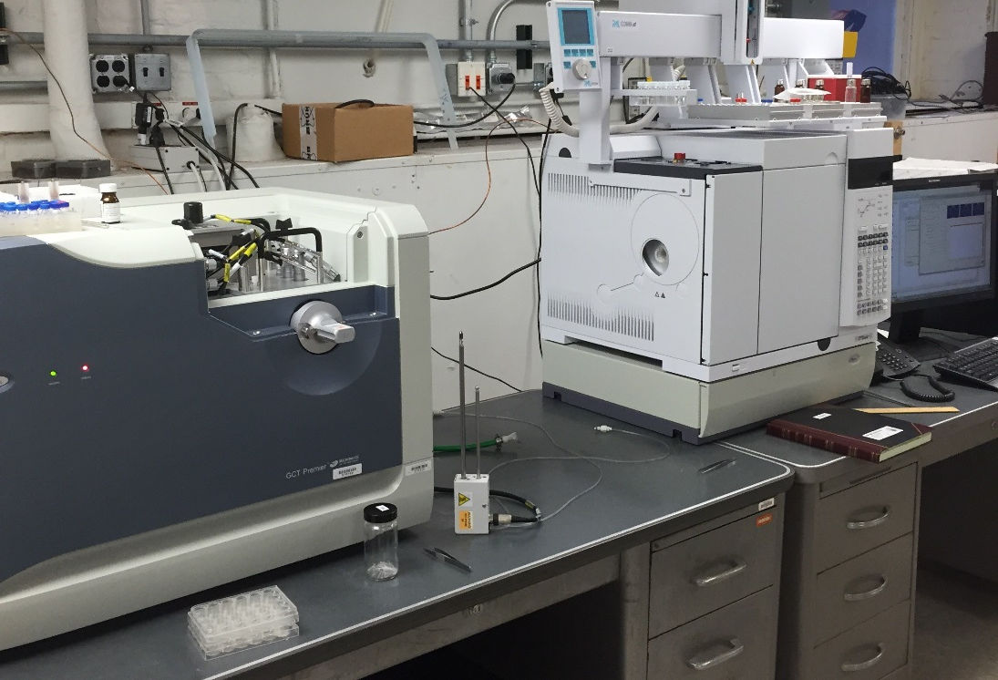
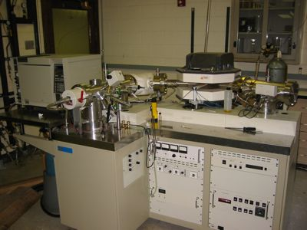
SCS Mass Spectrometry Laboratory
70-VSE
These instruments are used for EI/CI, FD/FI, FAB and GC/MS.
Waters GCT

Slide 5
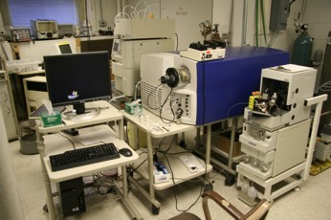
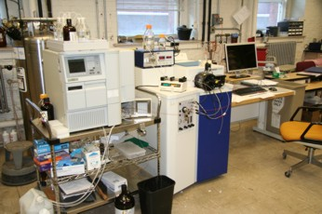
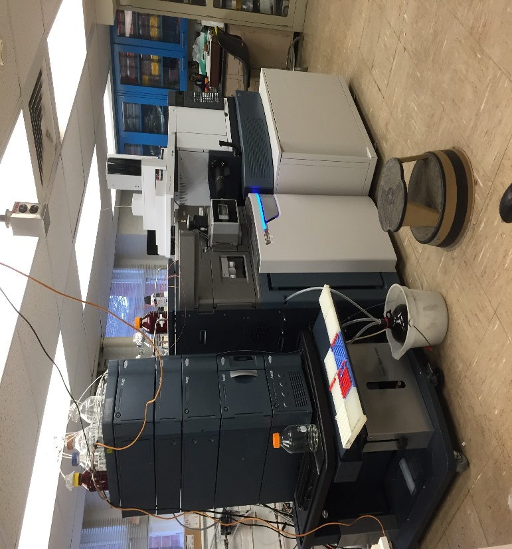
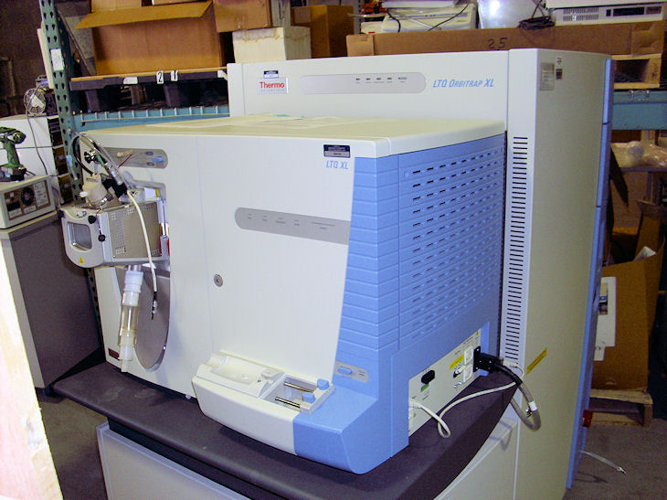
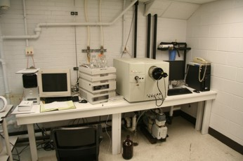
SCS Mass Spectrometry Laboratory
Quattro Ultima – ESI/APCI
Q-Tof - HR ESI, LCMS
Orbitrap – ESI, DESI
ZMD - LR ESI
Synapt – HR ESI, APGC
These instruments are used for LR and HR ESI and LCMS.

Slide 6
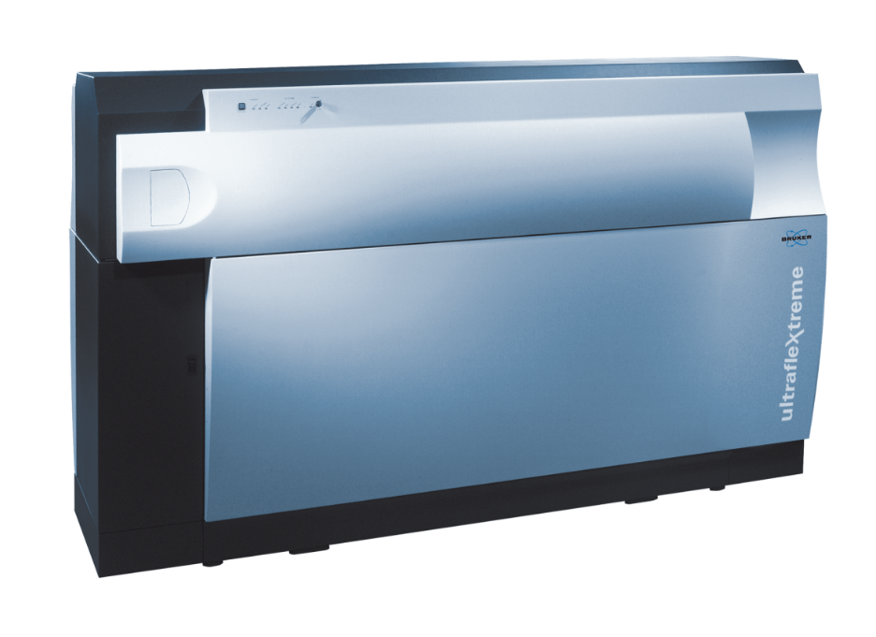
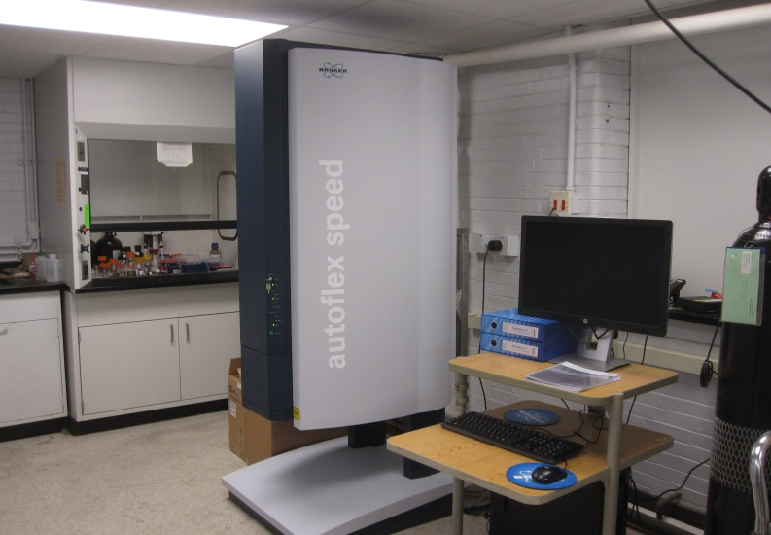
SCS Mass Spectrometry Laboratory
Bruker Daltonics UltrafleXtreme MALDI TOF-TOF
Bruker Daltonics
Autoflex Speed
MALDI

Slide 7
Mass Spectrometry for small molecules
Molecular Weight
    From molecular ion
      M⁺ or (M+H)⁺ [also (M+Na)⁺ or (M+K)⁺]
Structure
    From fragments
      Hard ionization
      MS/MS
Elemental Composition
    From exact mass

Slide 8
Mass Spectrometry for biomolecules
Molecular weight determination, structure information
  For example - Protein, peptides, DNA/RNA, Carbohydrates, Oligonucleotides, Oligosaccharide, Lipids, Natural products, Dendrimers, Porphyrins, Metalloporphyrins
Identification, sequence and modifications
  For example - Protein, peptides, DNA/RNA, Carbohydrates, Oligonucleotides, Oligosaccharide, Lipids, Natural products

Slide 9
Parts of a Mass Spectrometer
Inlet
Source
Analyzer
Detector
EI
CI
FI
FD
MALDI
ESI
APCI
APPI
Sector
Quadrupole
TOF
Ion trap
Orbitrap
Hybrid
Probe
Leak Valve
Syringe
Plate
GC
LC
Electron Multiplier
Photomultiplier
Array Detector
MCP

Slide 10
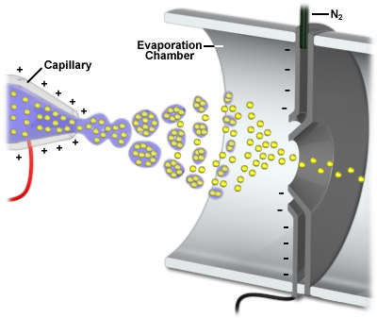
Features of Electrospray MS
Soft ionization – ions are produced in solution
It can be used for small and large molecules
Multiple charged ions are usually produced for large molecules
Suitable for using as an interface with HPLC
Fast data acquisition
High sensitivity, superior mass resolution and accuracy
Sample must be soluble and stable in
solution, polar relative clean

Slide 11
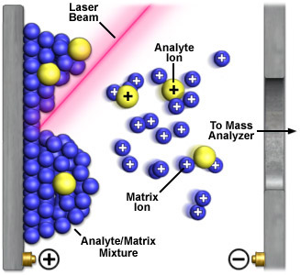
Features of MALDI-TOF MS
Soft ionization - analyze intact biomolecules and synthetic polymers
Broad mass range - analyze a wide variety of biomolecules
Simple mixtures are okay
Relatively tolerant of buffers and salts
Fast data acquisition
Easy to use and maintain, no water or
gas hook ups required
High sensitivity, superior mass
resolution and accuracy

Slide 12
Ionization Technique Summary
Ionization | Volatile | Thermal | Size of molecules | Amount | Examples
EI | Yes | Stable | Small | 1-2 mg | Organics
CI | Yes | Stable | Small | 1-2 mg | Organics
FI | Yes | Stable | Small | 1-2 mg | Organics
FD | No | Labile | Medium | 1-2 mg | Non-polar organics, organometallics, porphyrins, PAHs
MALDI | No | Labile | Large | 250fmol-500pmol | Peptides, proteins, DNA/RNA, polymers, dendrimers, fullerenes
ESI | No | Labile | Large | 1-300pmol/μL | Polar/ionic organics, peptides, proteins, biomolecules, organometallics, polymers

Slide 13
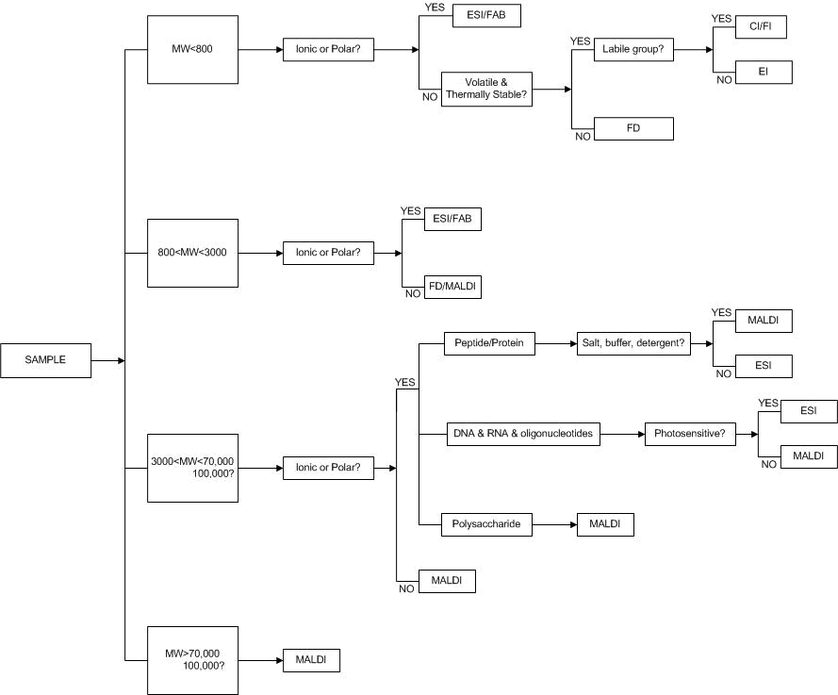
Flowchart of Mass Spectrometry Techniques
To print - use the landscape setting.

Slide 14
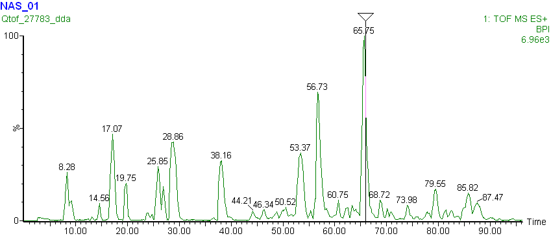
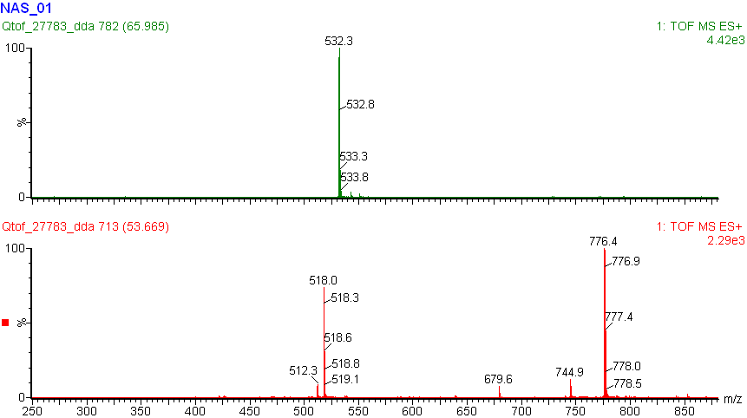
LCMS
Chromatogram
Mass Spectra

Slide 15
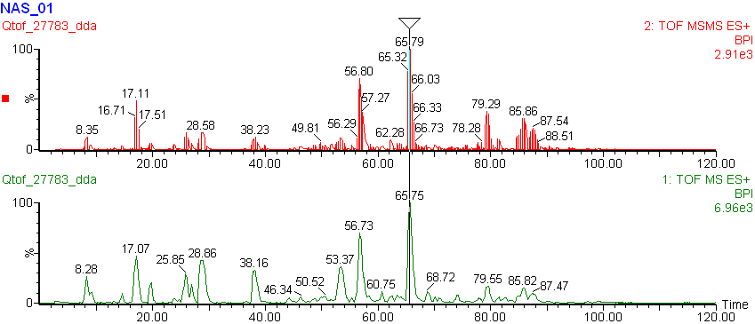
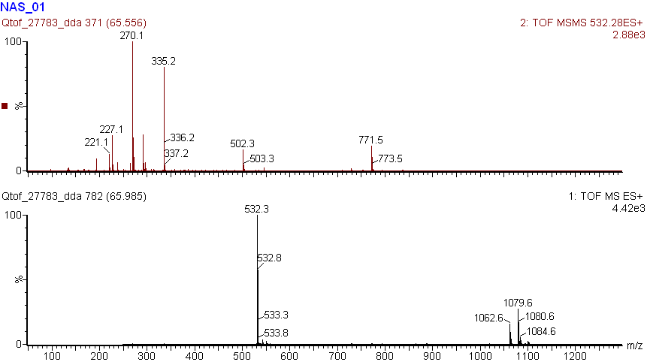
LC Tandem Mass Spectrometry (LCMSMS)
Chromatogram
Mass Spectra

Slide 16
LCMS Data Dependent Analysis (DDA)
Chromatogram
MS and MS2

Slide 17
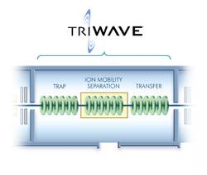

TWIM (Traveling Wave ion mobility)
Separates mixture of ions by their shape, size and charge status

Slide 18
Thank You

