Slide 1
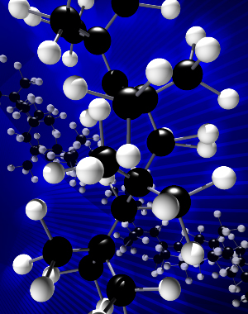

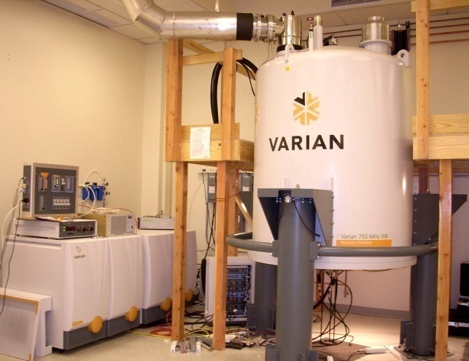
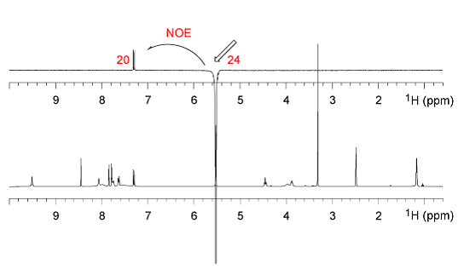
The NMR Lab at the
School of Chemical Sciences
University of Illinois
Andre Sutrisno
Solids NMR
Dean Olson
Director
Nikki Duay
Technical Assistant
Lingyang Zhu
Liquids NMR
Pre-Pandemic SCS Holiday Party – Dec. 2019

Slide 2
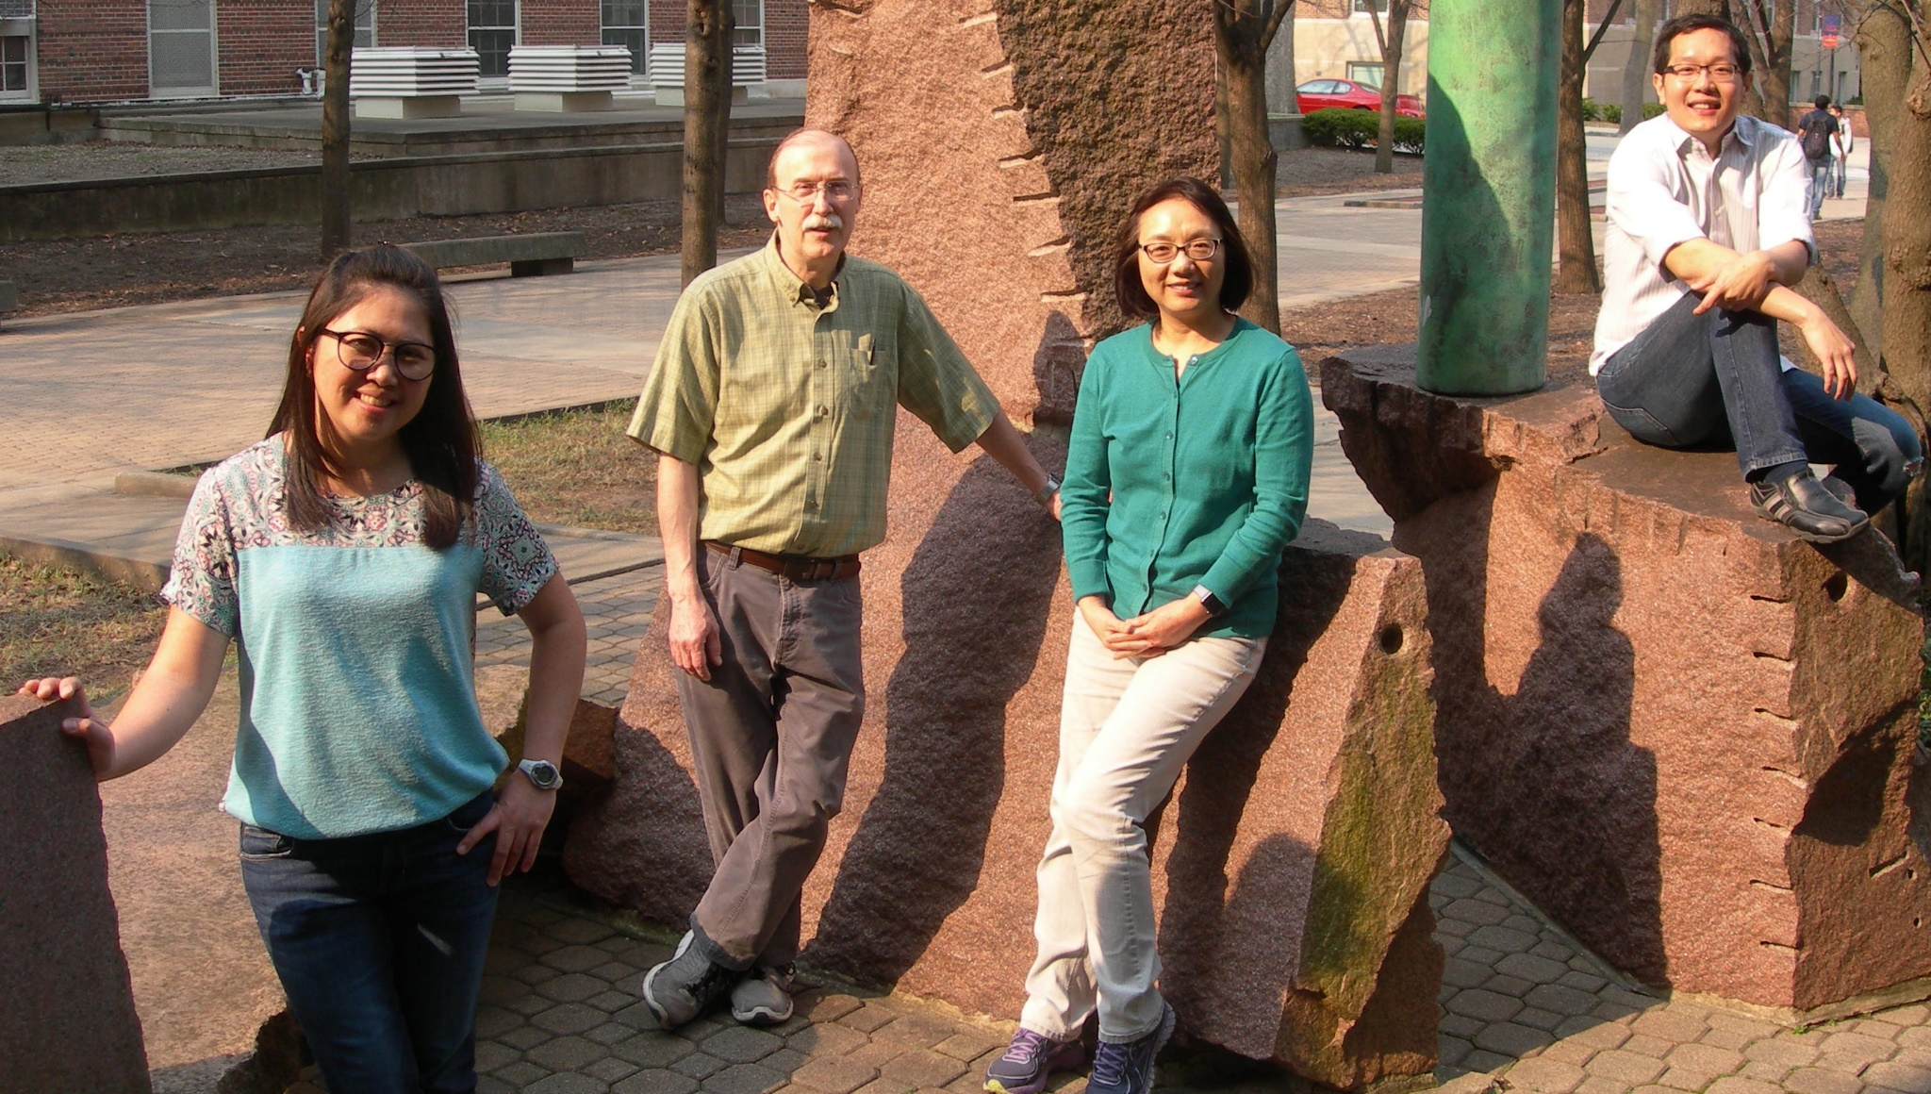
Nikki Duay – Technical Assistant since April 2018
Dean Olson – Director since December 2010
Lingyang Zhu – Liquids NMR since November 2011
Andre Sutrisno – Solid State NMR since June 2014
55 Noyes
55 Noyes

Slide 3
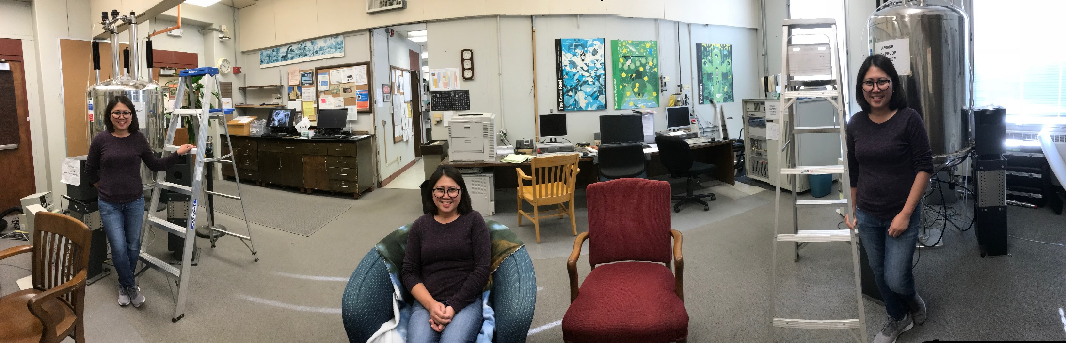
The NMR Lab at the
School of Chemical Sciences
University of Illinois
Nikki … Nikki … Nikki

Slide 4
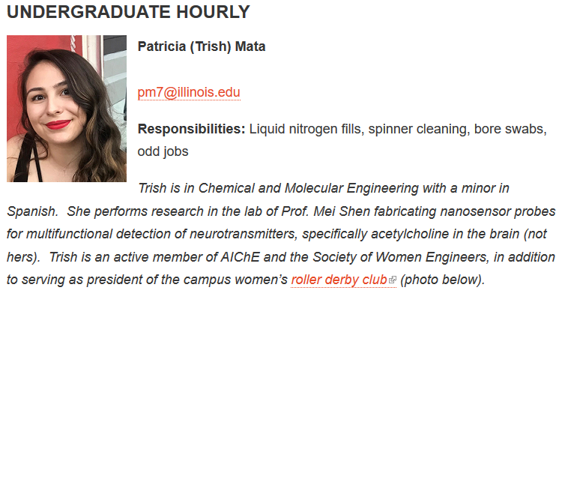
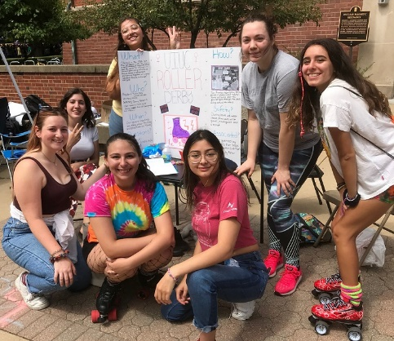
The NMR Lab at the
School of Chemical Sciences
University of Illinois
Since May 2019

Slide 5
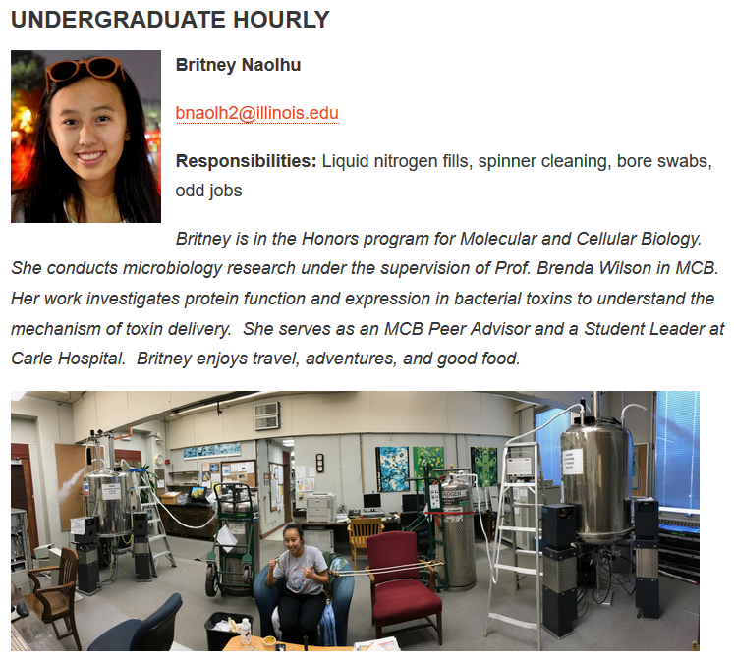
The NMR Lab at the
School of Chemical Sciences
University of Illinois
Since May 2019

Slide 6
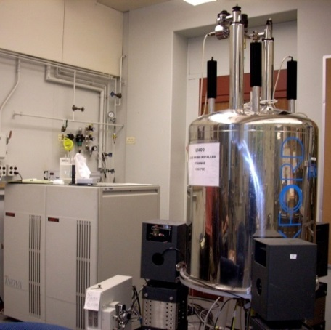
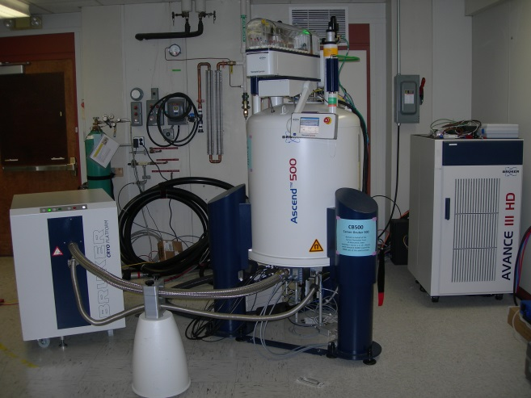
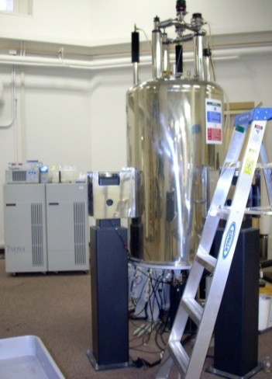
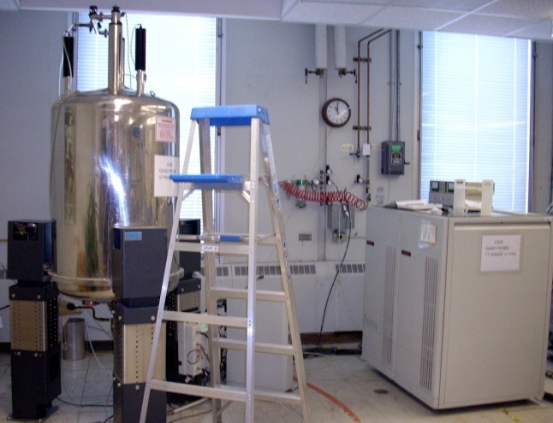
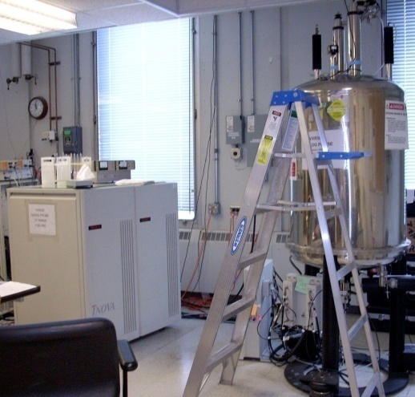
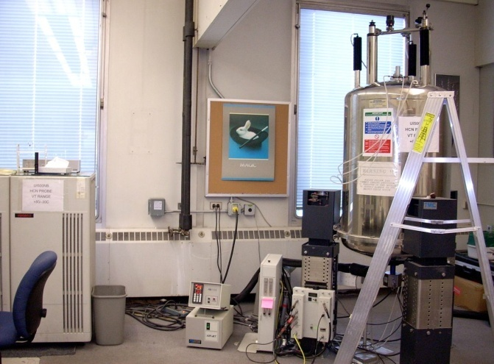
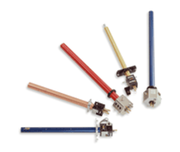
Solution State NMR Spectrometers
146 RAL
55 Noyes
NMR Lab Overview
400 MHz:
Nalorac QUAD probes (H/F, C/P or B/P)
500 MHz: CB500
CryoProbe with 45 Nuclei
600 MHz: AutoX BB and HCN probes
H/F, C/P probe
H/F, C/P w PFG Z probe
500 MHz: Varian HCN PFG Z probe
500 MHz: Nalorac QUAD probes
Notes:
2- 400 MHz spectrometers equipped with Nalorac QUAD probes in the configuration of H/F and C/P or P/B detection; a 600 MHz spectrometer with an AutoX BB probe and readily switched in HCN PFG XYZ probe and 3- 500 MHz spectrometers, two of which are equipped with Nalorac QUAD probes and one which uses primarily a Varian HCN PFG Z probe for indirect detection work.

Slide 7
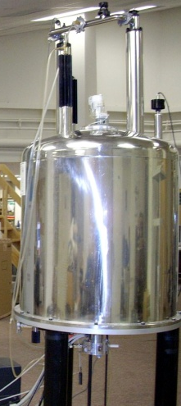
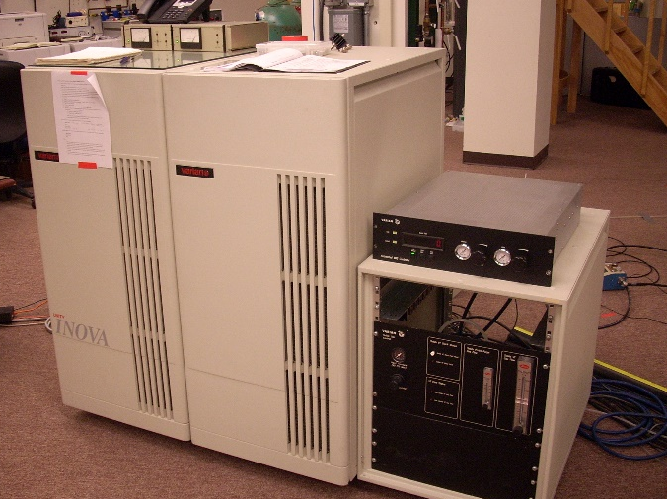
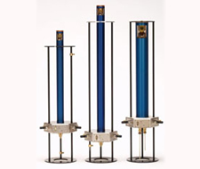
Solid State NMR Spectrometers
55 Noyes
NMR Lab Overview
300 MHz WB Solids:
Chemagnetics probes
4 mm / 7.5 mm HX MAS
See Andre Sutrisno
Notes:
I would like to move on to a discussion related to my current position at UIUC by beginning with an overview of our facility. My primary job is to oversee and maintain the solid-state NMR spectrometers. We currently have 3 operational spectrometers, a 300 Mhz WB, a 500 MHz WB and a 750 MHz WB. The 750 MHz WB is our newest addition and is equipped with a 5-channel VNMRS console and a variety of prototype solids probes. The 500 WB was just upgraded to the VNMRS console last year and our 300 Unity Inova WB is both liquids and solids compatible.

Slide 8
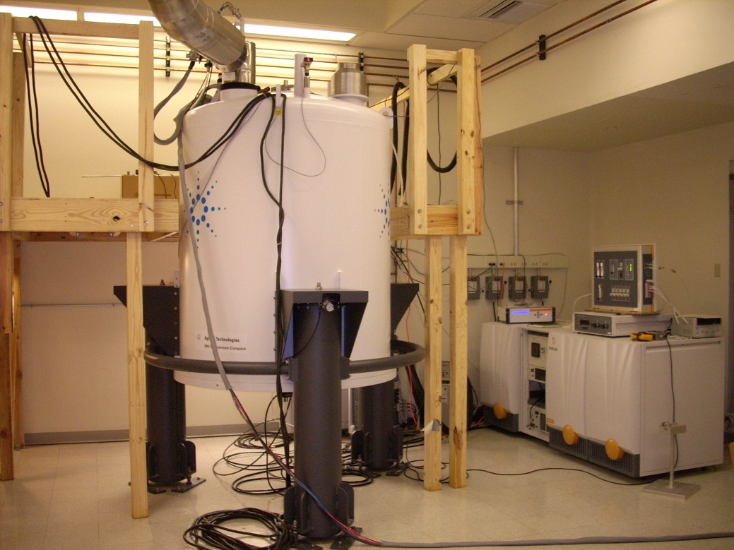
Solution/Solid State 750-MHz NB NMR Spectrometer
A151 CLSL
NMR Lab Overview
750NB:
5mm ¹H{¹³C/¹⁵N} PFG probe
10mm ¹⁵N-³¹P BB probe
10mm ⁷³Ge-¹⁵N BB probe
3mm ¹³C{¹H} probe
4mm ¹⁵N-³¹P CPMAS Probe
See Lingyang for liquids NMR
See Andre for ssNMR
But wait - there’s more …

Slide 9
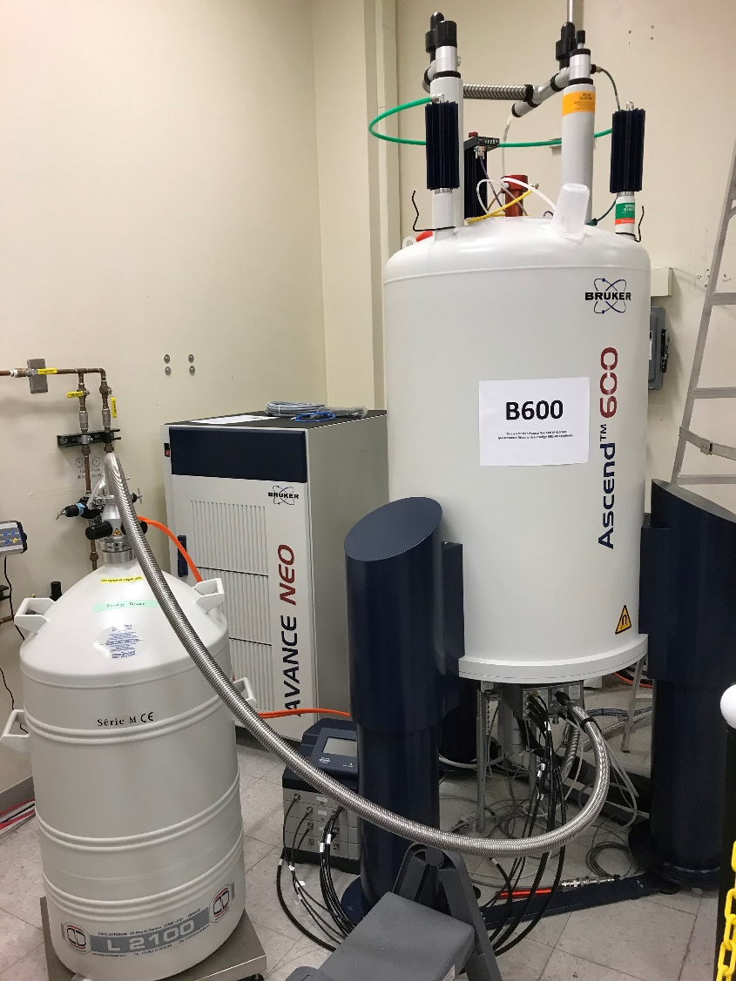
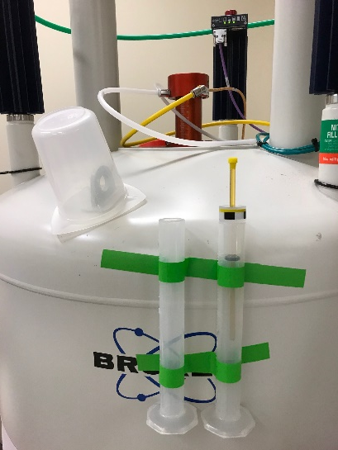
New 600-MHz
Solution State NMR Spectrometer
Bruker 600 MHz: B600
Prodigy CryoProbe
LN₂ - Based
Enter via
A149 CLSL
NMR Lab Overview
No Automation (yet):
Manual Sample Entry
Cost = $1.3 M
https://scs.illinois.edu/resources/cores-scs-service-facilities/nmr-lab/instrument-information/b600-bruker-neo-nmr
Notes:
2- 400 MHz spectrometers equipped with Nalorac QUAD probes in the configuration of H/F and C/P or P/B detection; a 600 MHz spectrometer with an AutoX BB probe and readily switched in HCN PFG XYZ probe and 3- 500 MHz spectrometers, two of which are equipped with Nalorac QUAD probes and one which uses primarily a Varian HCN PFG Z probe for indirect detection work.

Slide 10
New 600-MHz
Solution State NMR Spectrometer
Bruker 600 MHz: B600
Prodigy CryoProbe
LN₂ - Based
Enter via
A149 CLSL
NMR Lab Overview
Unique Capabilities:
About 2-3-fold higher sensitivity than a
non-CryoProbe 600.
C-13 acquisition with standard proton decoupling.
C-13 acquisition with F-19 decoupling.
C-13 acquisition with deuterium decoupling.
C-13 acquisition with simultaneous decoupling of
proton and deuterium.
Use:
Some walk-up
Some specialty use
Later:
Another Probe
In-the-Tube Mixing
Notes:
2- 400 MHz spectrometers equipped with Nalorac QUAD probes in the configuration of H/F and C/P or P/B detection; a 600 MHz spectrometer with an AutoX BB probe and readily switched in HCN PFG XYZ probe and 3- 500 MHz spectrometers, two of which are equipped with Nalorac QUAD probes and one which uses primarily a Varian HCN PFG Z probe for indirect detection work.

Slide 11
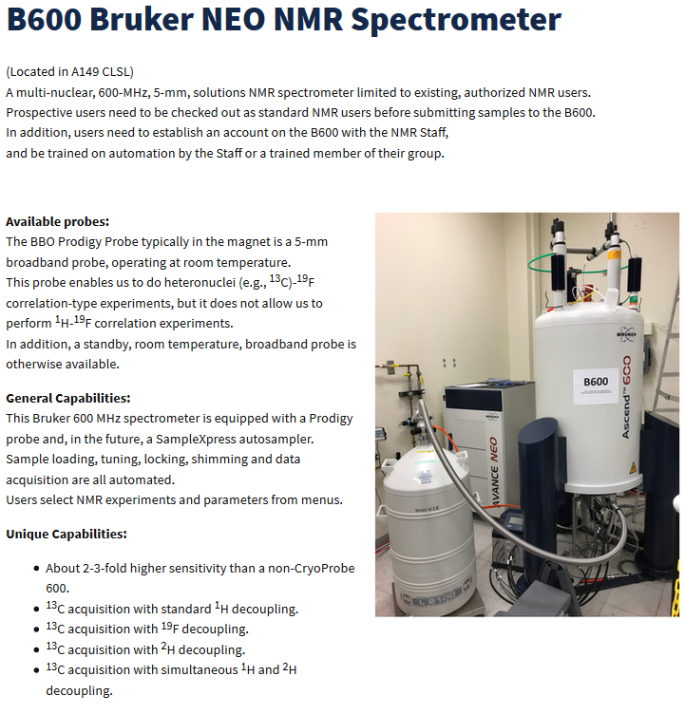

New 600-MHz
Solution State NMR Spectrometer
Bruker 600 MHz: B600
Prodigy CryoProbe
LN₂–based electronics cooling
NMR Lab Overview
90 NMR
Experiments
Special Decoupling
Capabilities
Notes:
2- 400 MHz spectrometers equipped with Nalorac QUAD probes in the configuration of H/F and C/P or P/B detection; a 600 MHz spectrometer with an AutoX BB probe and readily switched in HCN PFG XYZ probe and 3- 500 MHz spectrometers, two of which are equipped with Nalorac QUAD probes and one which uses primarily a Varian HCN PFG Z probe for indirect detection work.

Slide 12
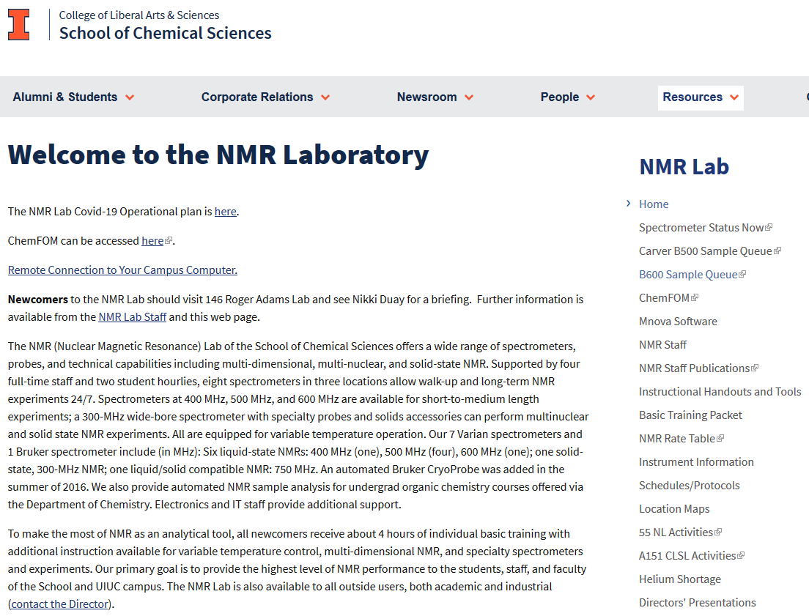
NMR Lab Overview
Notes:
You can find all the information about the instruments, training manual, useful handouts, and scheduling and contact information etc. at the SCS NMR website. I hope you booked mark it and in your favorites on your computer for easy access.

Slide 13
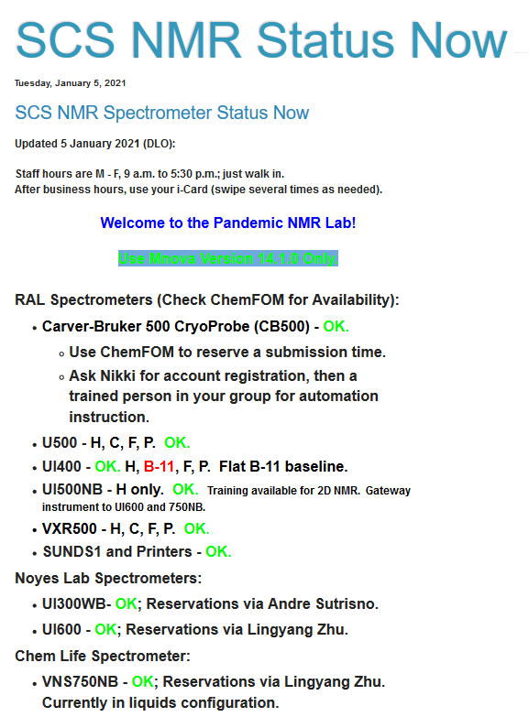
SCS NMR Blog

Slide 14
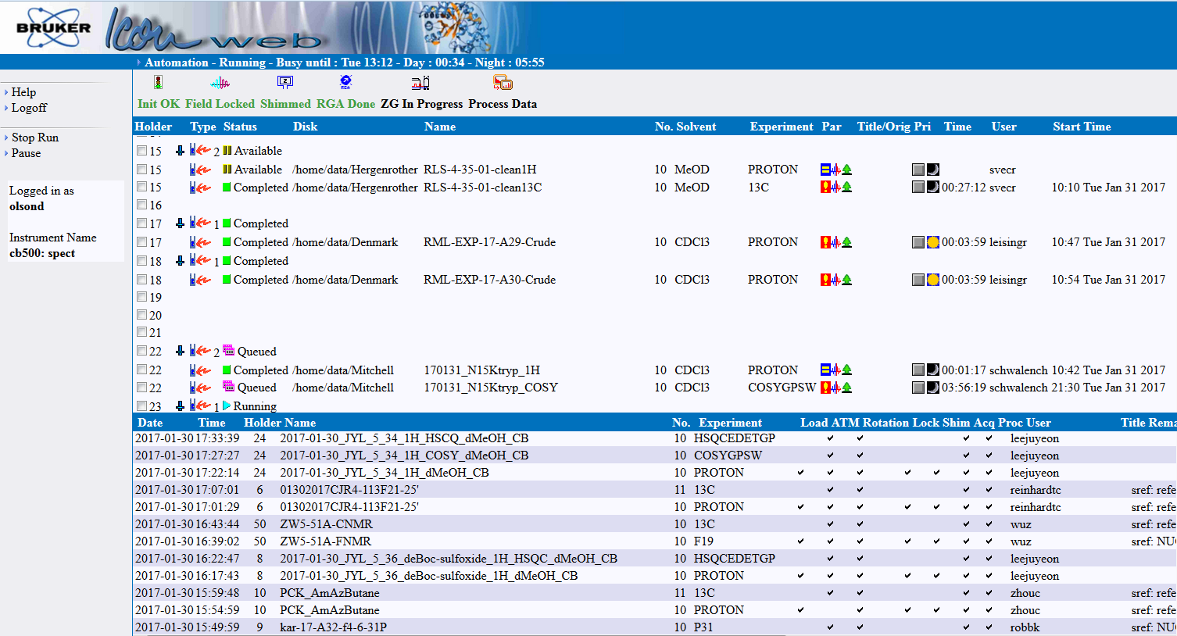
SCS NMR CB500 or B600 Status

Slide 15

NMR Training
Director e-mails 28 items:
NMR principles, Mnova, i.p. address, etc.
Get a booklet
and see Nikki
for paperwork
& ChemFOM
Study and exercises;
Training by Liaison
Check-Out by
Director
Gateway Instrument
UI500NB Training
by Director
(2D-NMR Prep)
Special 1D,
2D/3D-NMR Training
by Lingyang
Temperature Control
(VT) Training
by Director
pw90 calibration
T₁ calibration
Solvent suppression
Gateway to UI600 and 750NB with Lingyang
Required for UI600 and 750NB
One key 2D document:
UI500NB Advanced 1D and 2D NMR
Solid State NMR Training
by the Solids Spectroscopist

Slide 16
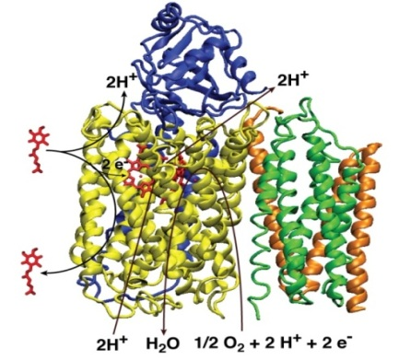
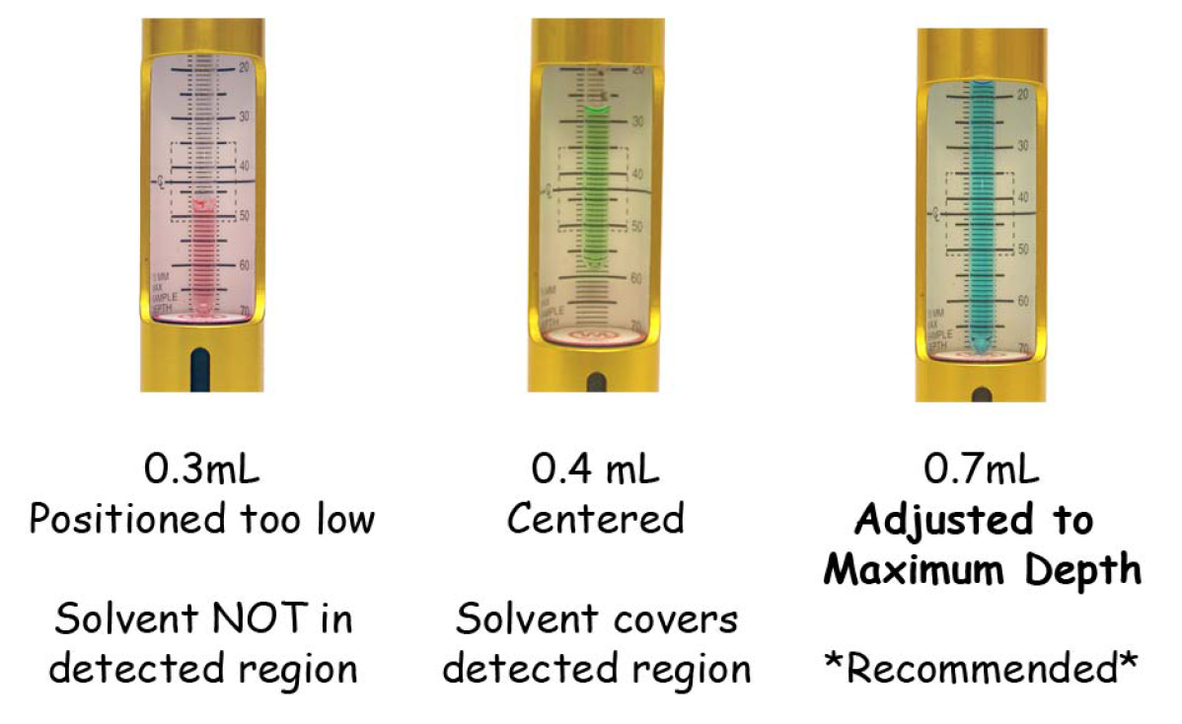
Common Problems
- in the training booklet
NMR Lab Overview
From an MIT web document

Slide 17
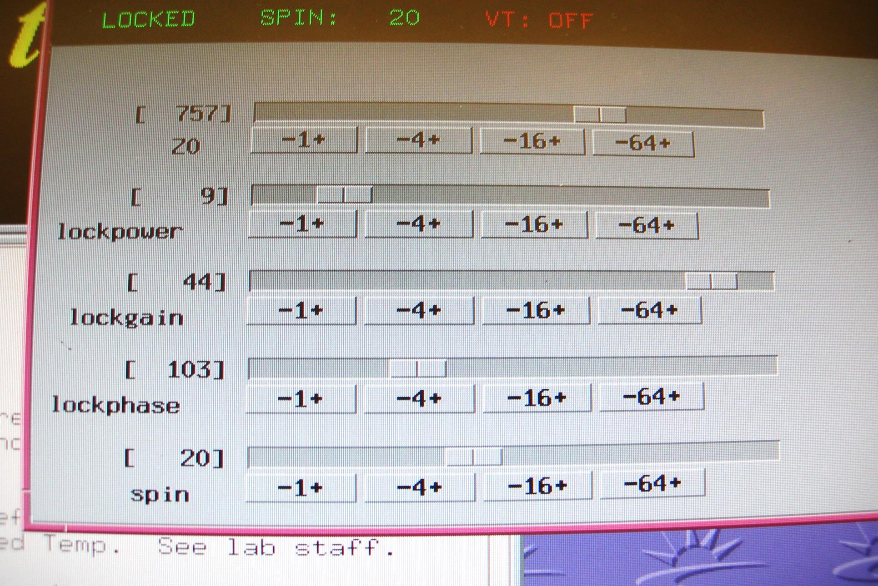
Common Problems - getting this backwards
NMR Lab Overview
Best if Lower
Best if Higher

Slide 18
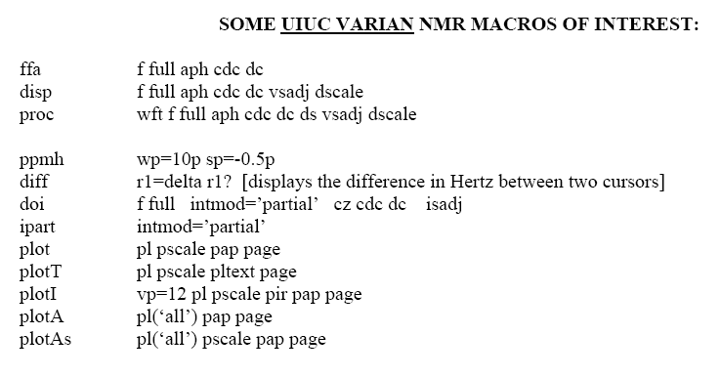
A Few Under-Appreciated NMR
Data Processing Shortcuts
In the training booklet
Some easier on Mnova
p7 references the chloroform ¹H residual signal to 7.26 ppm (select peak first)
p77 references the chloroform ¹³C residual signal to 77.0 ppm (select peak first)
diff displays difference between 2 cursors in Hz (r1 = Hz)
nl vsadjcr adjusts selected peak to be the maximum on y scale

Slide 19
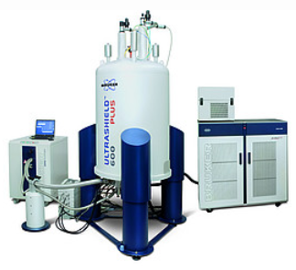

Bruker NMR - 500 MHz
Classic CryoProbe
Carver Bruker 500:
CB500
Since July 2016
Funding from the
Carver Charitable
Trust: $500 K
Total Purchase
Price: $895 K
Today: $1.20 M
NMR Lab Overview

Slide 20
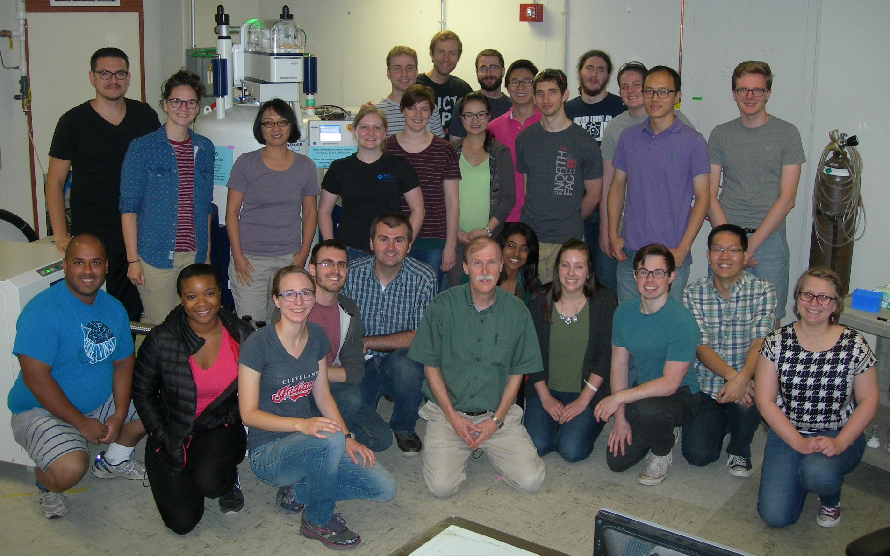
Bruker NMR - 500 MHz
Classic CryoProbe
Carver Bruker 500:
CB500
Since July 2016: LHe-based electronics cooling
NMR Lab Overview

Slide 21
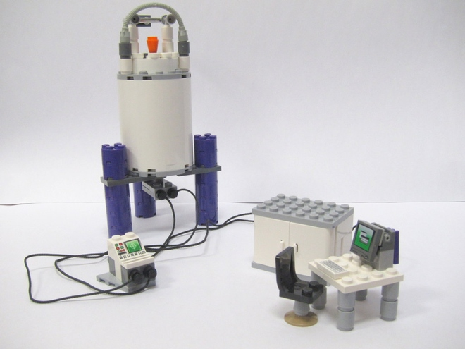

Bruker NMR - 600 MHz
Prodigy CryoProbe
LN₂-based electronics cooling; more versatile
NMR Lab Overview

Slide 22
Why Visit the NMR Lab?
“I wish I had done more NMR sooner.”
- Quote from a 6th year grad student

