Slide 1
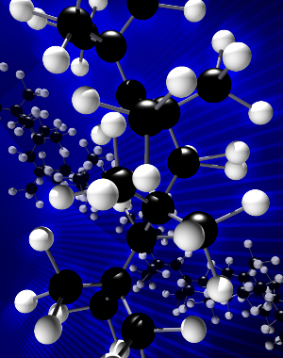
The EPR Lab at the School of Chemical Sciences University of Illinois
Electron
Paramagnetic
Resonance
Also called ESR (Electron Spin Resonance) or EMR (Electron Magnetic Resonance)
Uses permanent electromagnets (therefore can be turned on/off on a regular basis), as opposed to superconducting magnets in NMR
EPR Lab Overview
Notes:
1

Slide 2
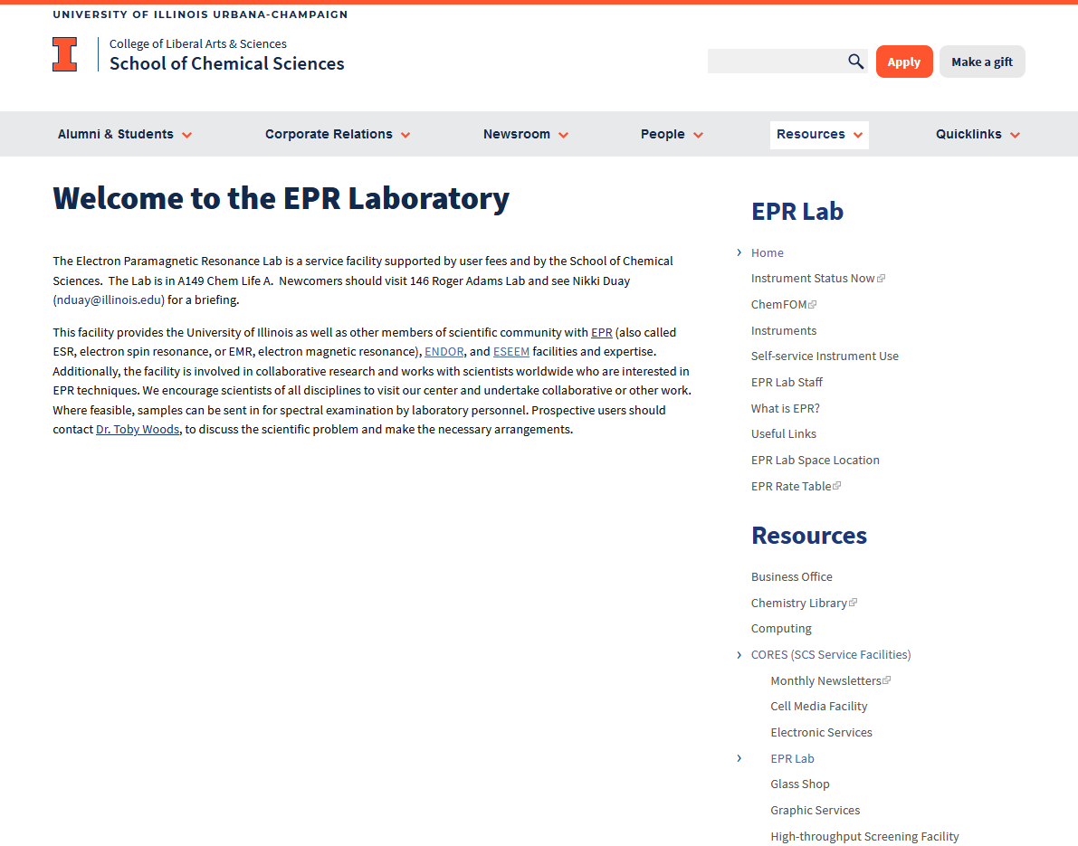
EPR Lab Overview

Slide 3
EPR tells you what nuclei the unpaired electron interacts with
EPR Lab Overview
Notes:
12 H atoms at I = ½. 2(12)(1/2) + 1 = 13 lines

Slide 4
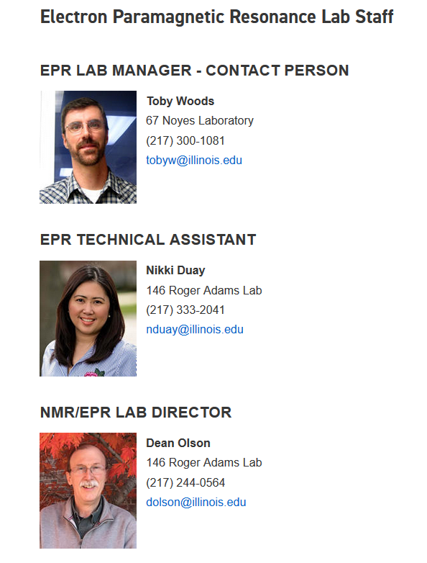
EPR Lab Overview

Slide 5
EPR Lab Overview
A149/151 CLSL

Slide 6
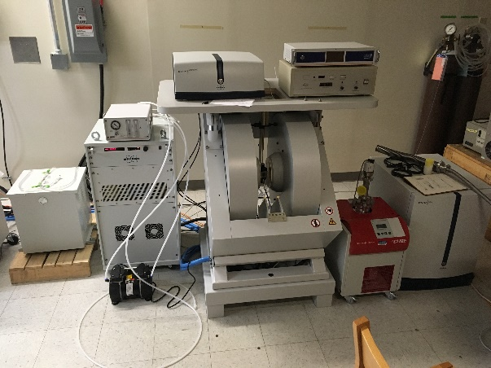
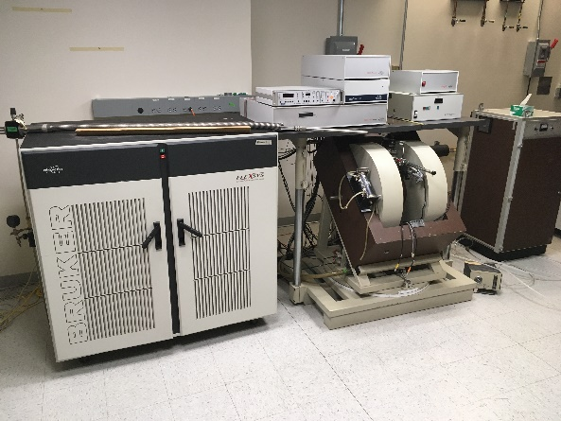
EPR Spectrometers
A149 CLSL
Elexsys1
E-10” FT EPR
(E580 series)
Pulse/CW mode
X-band (8-10 GHz)
S-band (3 GHz)
Q-band (35 GHz)
5-300 K helium cryostat
EPR Lab Overview
EMXplus
CW/dual band mode
X-band (8-10 GHz)
5-300 K with helium cryostat
77K with LN₂ finger Dewar
Notes:
6

Slide 7
EPR Training
EPR Lab Overview

