Slide 1

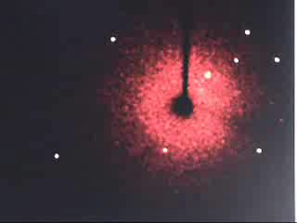
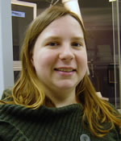
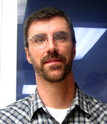
Danielle L. Gray
dgray@illinois.edu
244-1708
Toby Woods
tobyw@illinois.edu
300-1081
Business Hours 8:30a - 12:00p and 1:00p - 4:30p Monday - Friday
Consulting Hours 10:00a - 11:00a and 2:00p - 3:00p Monday - Friday
Laboratory Entry Northeast Ground Floor Noyes, Room 60

Slide 2
Brief History
1912 Laue, Friedrich, Knipping, Crystals diffract
1895 Roentgen, Discovers X-rays
1914 Bragg and Lawrence, solve atomic positions
1953 Rosalind Franklin, structure of DNA
1993 Bruker produces first CCD detector
2019 New Photon2 Detector installed
1928 Lonsdale, structure of benzene
1915 Both Braggs, win Nobel Prize in Physics
2014 IYCR
1979 Sheldrick, writes SHELXTL

Slide 3
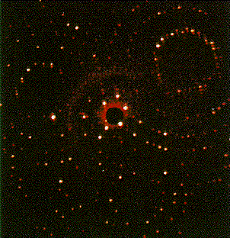
Overview
SHELXTL
XPREP
XS
XP
P 21/n
a = 23.3481(4)
b = 12.3868(2)
c = 23.8191(1)
beta = 92.756(1)
Chemistry
XL

Slide 4
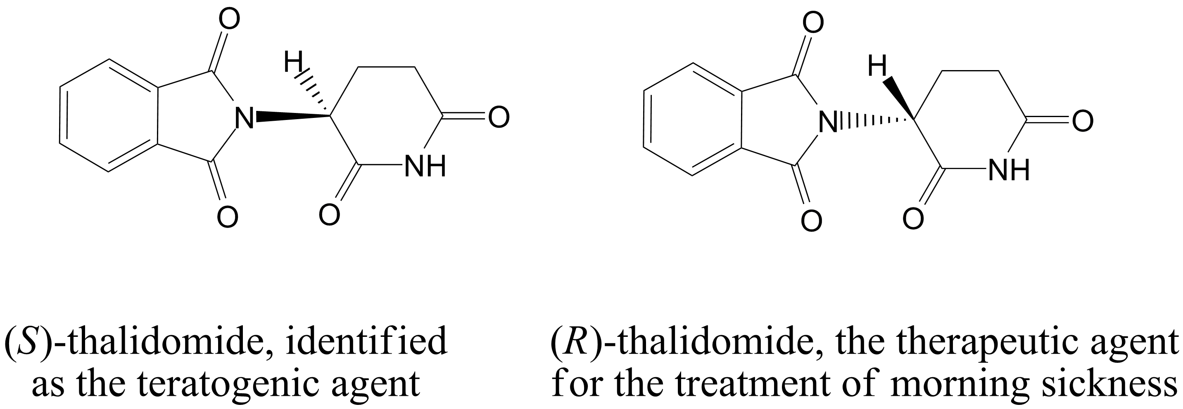
Organic Chemistry and Crystallography it matters

Slide 5
Absolute structure without a heavy atom
Crystallize the compound with a component of known stereochemistry
Bijvoet Pairs (h k l and -h -k -l) need to be examined for anomalous scattering effects
Centrosymmetric vs. Non-centrosymmetric
F_{hkl} = F_{-h-k-l}
F_{hkl} ≠ F_{-h-k-l}
Flack and/or Hooft
Analysis
In order to measure anomalous scattering effects, you must be using a radiation near the absorption edge of the atom types. You MUST have Cu radiation for light atom structures!

Slide 6
The main pitfall of absolute structures
Is the crystal examined a representative of the bulk crystals?
  Racemic mixtures can crystallize
    As a centrosymmetric crystal
    As a non-centrosymmetric crystal that is twinned
    Each individually as non-centrosymetric crystals
  Circular dichroism or enantioselective chromatography to test if crystal is the same as bulk

Slide 7
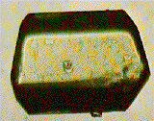
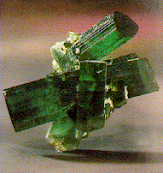
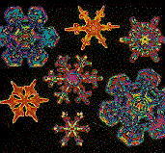
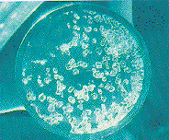
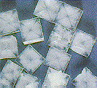

Crystal Quality is Essential
YES
MAYBE
NO

Slide 8
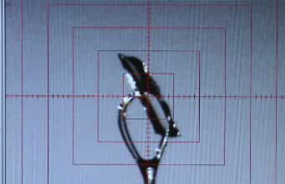
The Ideal Sample
The ideal sample, like this 40 x 70 x 360 μm crystal mounted on a 300 μm
cryo-loop, is attached using an inert oil, frozen in place using a cold gas
stream, and recovered after the diffraction experiment is finished.
Like many spectroscopic techniques, the overall amplitude of the diffraction
pattern is proportional to sample volume. There are no limits on crystal
morphology, but the practical range of linear dimensions is 5 to 500 μm.
Air, temperature, and light sensitive samples are routinely used.

Slide 9
Growing “good” crystals
Solvent Cooling
Solvent Evaporation
Layering Liquid/Liquid diffusion
Vapor Diffusion
Sublimation
No matter how you grow the crystals, bring them to the X-ray facility the way you grew them!
NOT
DO REMOVE THE SOLVENT!

Slide 10
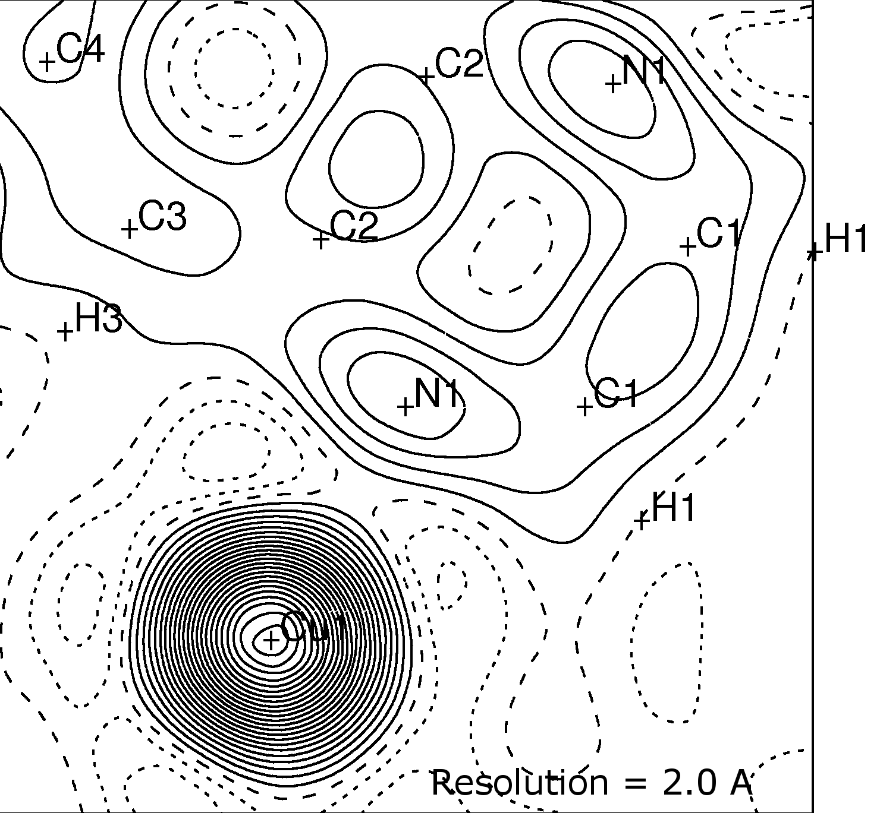
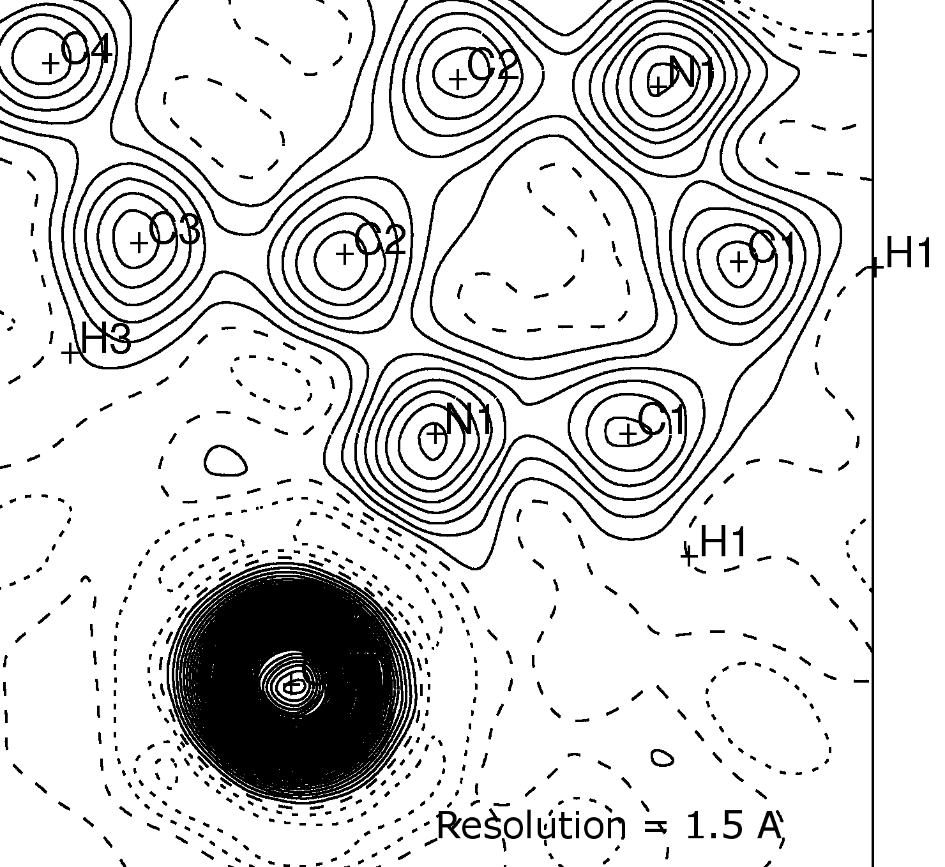
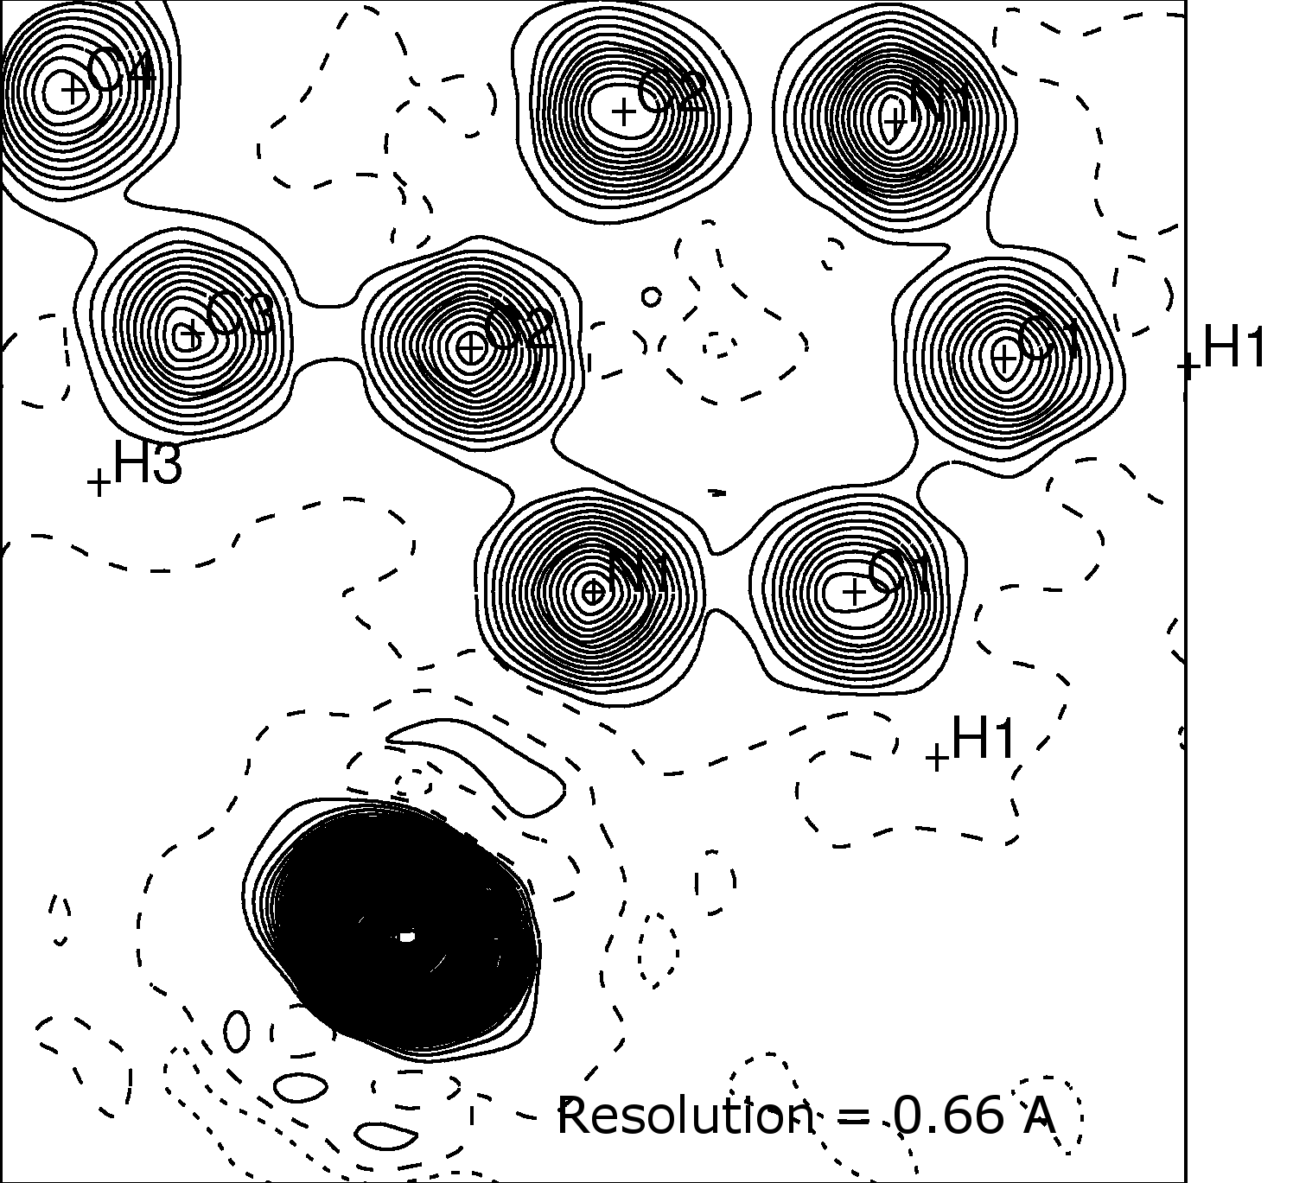

Slide 11
Static deformation density map:
Essentially the total electron density minus spherical core electron density
Electrostatic Potential Maps:
Same idea as an ESP map generated by a DFT calculation but it is derived from experimental information
(same Se complexes as on previous slide)

Slide 12
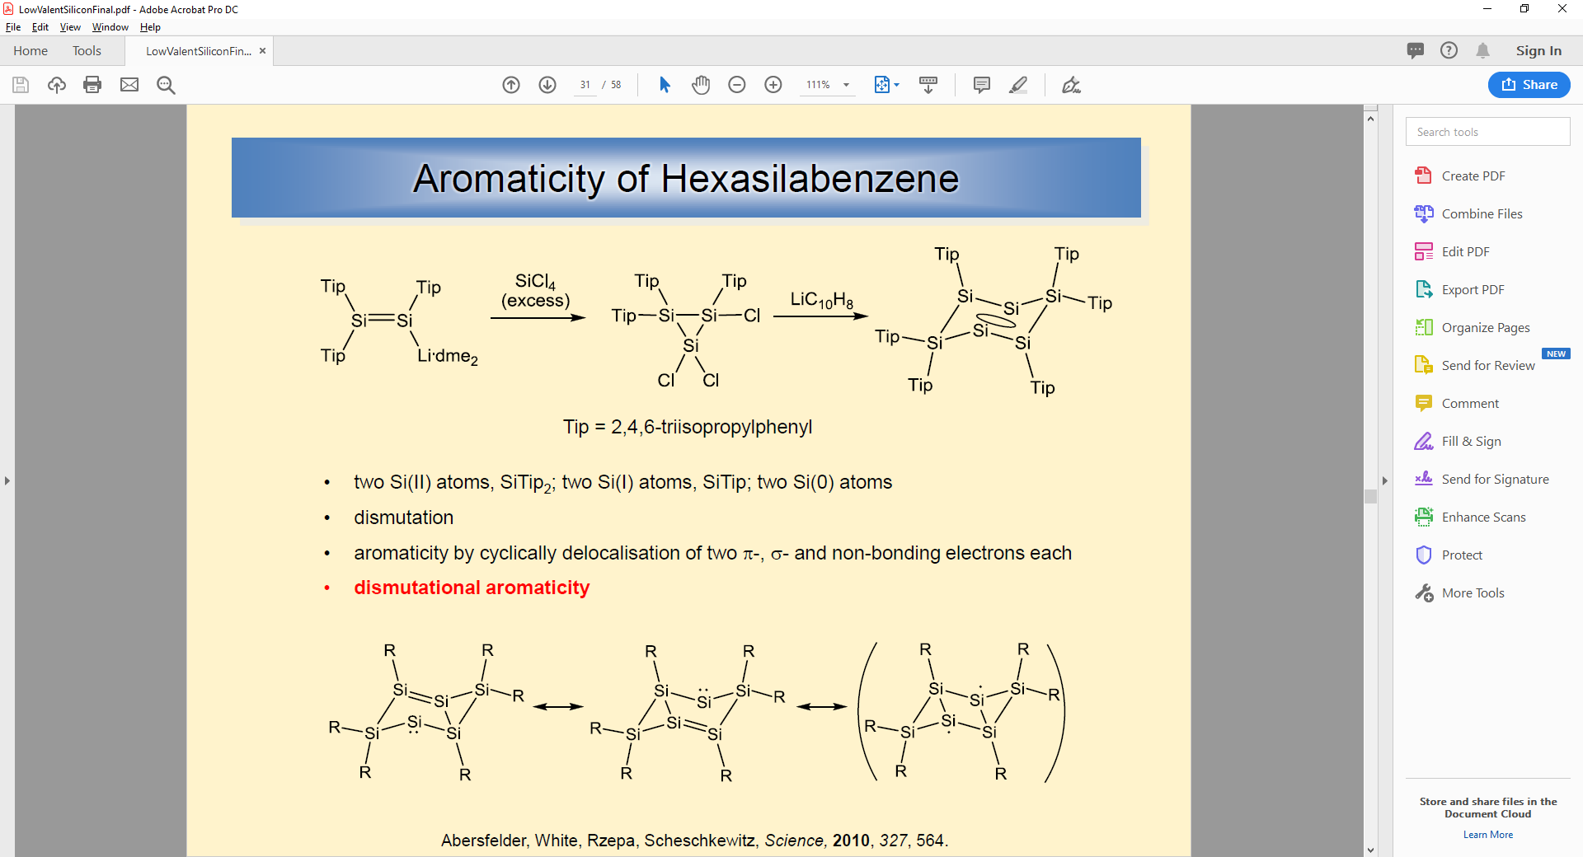
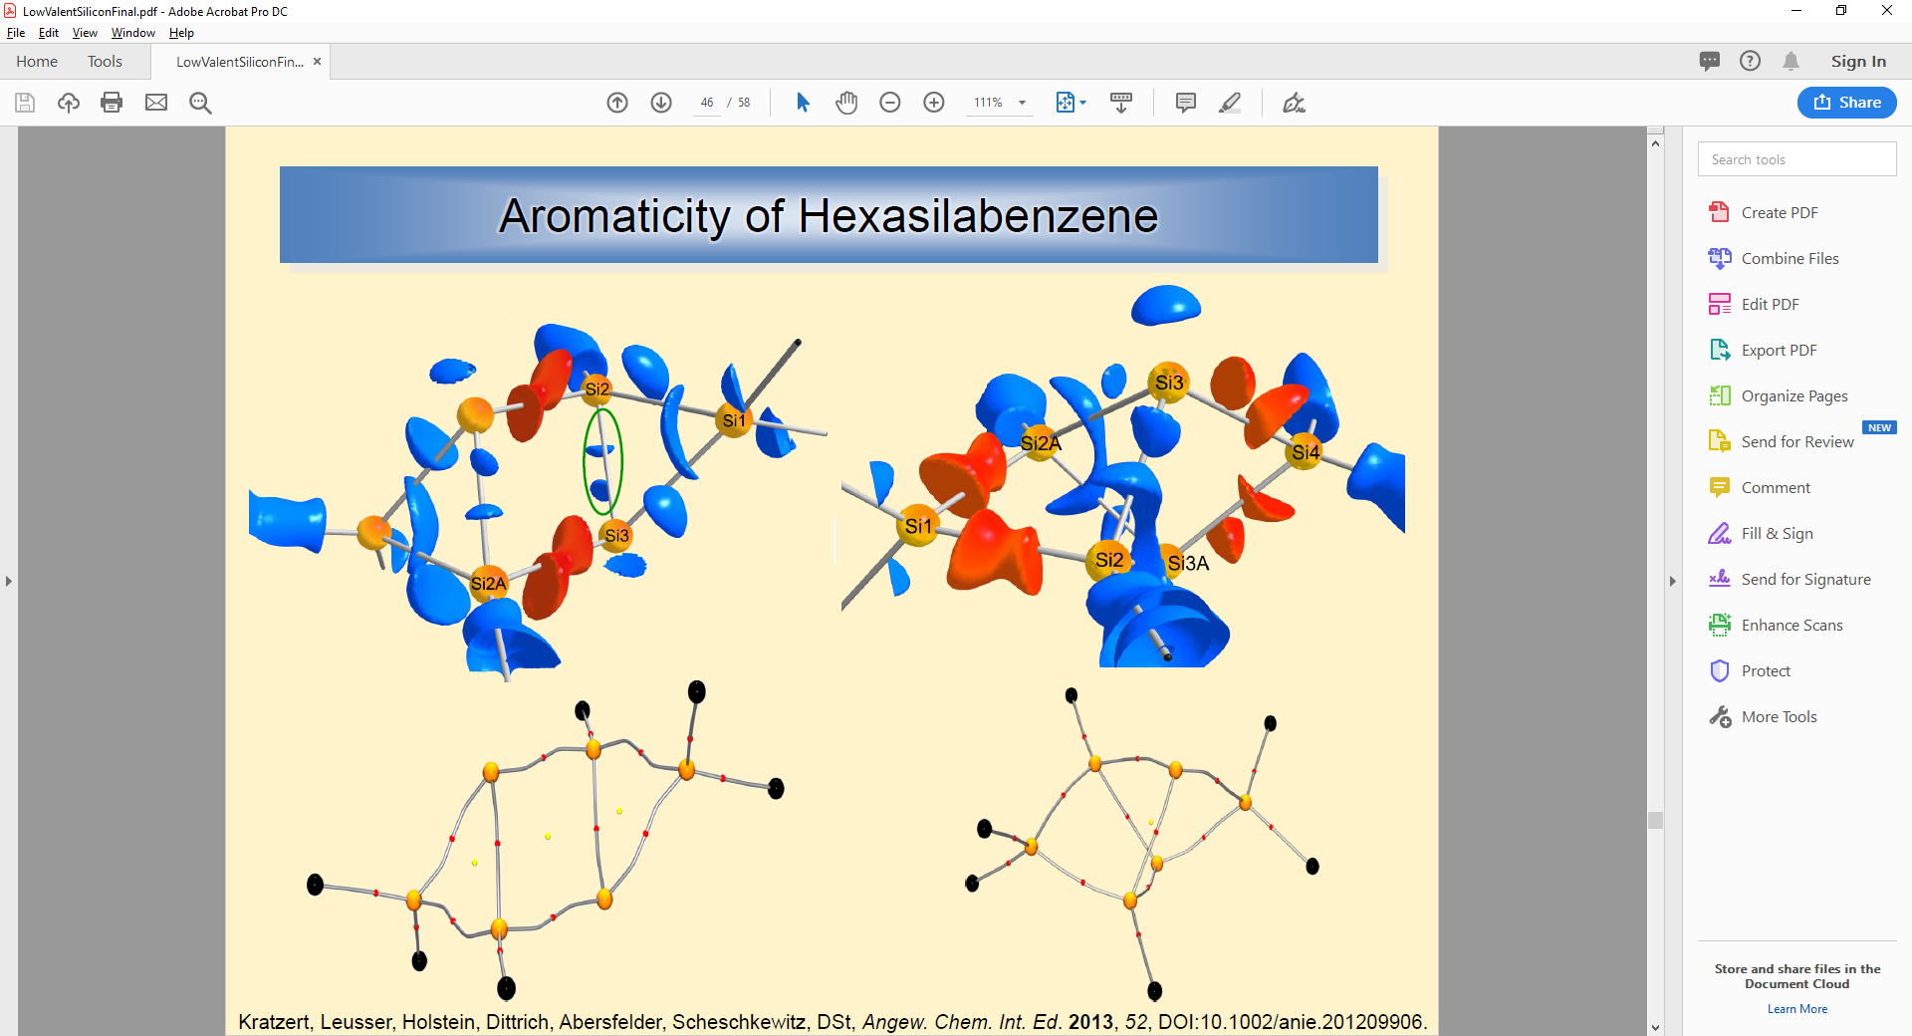
Hexasilabenzene
Which resonance structure is correct, or is the system an average of the three?
Bond paths (gray lines) and bond critical points (red spheres) provide an experimentally observable definition of a “bonding interaction”

Slide 13
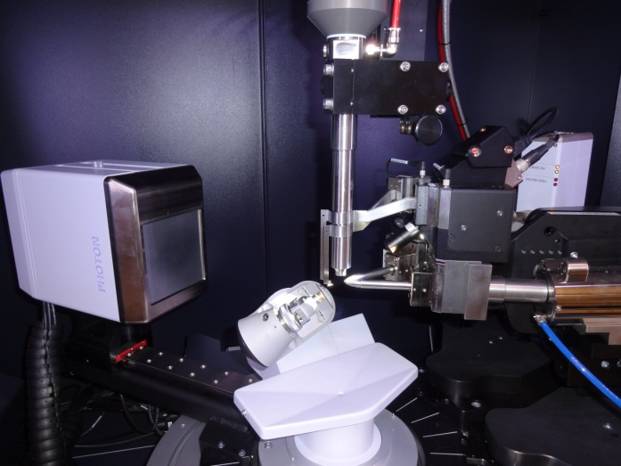
You too can learn to collect and solve your own structures!
  - How to pick a good crystal
  - How to collect a data set
  - How to integrate a data set
  - How to solve a structure using OLEX2/SHELX
User run Staff run
Screening the crystals (Unit Cell) $33.71 $57.26
Data Set $103.36 $175.58
Structure Solution $212.30 $360.64
Charge Density Analysis Price TBD

