Slide 1

ESCO Project 5 – Lab Building Upgrades
Josh Whitson (UIUC - F&S), Ty Miller (Schneider Electric), John Randtke(Schneider Electric), Darrell Demoss (Schneider Electric), Josh Kramer (Schneider Electric)
October 17, 2018
Notes:
Give agenda while on cover slide

Slide 2
Agenda
What is Energy Performance Contracting?
History at UIUC
Project Overview
Program Results
Range of Scope
Laboratory Project Goals
Schneider Electric Introduction
Project Approach
Notes:
Give agenda while on cover slide

Slide 3
Energy Performance Contracting (EPC)
What is an EPC
  Type of design/build project with a performance guarantee
  Turnkey service
    Audit + engineering + construction + commissioning + O&M + long-term savings measurement/guarantee
  Delivers comprehensive utility savings
  Project risk transferred to Energy Services Company (ESCO)
  Project savings are used to pay project costs
    20 Year Payback Maximum
Owner
Energy Service Company
Project Delivery Benefits
  Guaranteed Energy Savings
  Aligned Goals
  Guaranteed Maximum Price
  Contract Structure / Single Point of Contact
  Bidding Process
Subcontractors

Slide 4
Energy Performance Contracting (EPC)
Process
  Original RFP
  8 Prequalified ESCOs
  Identify Potential Project
  Competitive Selection Process
  Investment Grade Audit
  Energy Services Agreement
Total Contracted to Date: $75M
Completed/Active Projects
  College of Veterinary Medicine
  Oak Street Chiller Plant
  College of Engineering (5 Buildings)
  Abbott Power Plant
Vet Med EPC #1 Project Begins
Vet Med EPC #1 & Oak Street Chiller Plant EPC #2 Projects Complete
October
April
Abbott Power Plant EPC #4 Project Begins
Abbott Power Plant EPC #4 Project Complete
RFP Phase 1
UIC EPC Project
January
March
June
June
Oak Street Chiller Plant EPC #2 Project Begins
College of Engineering EPC #3 Project Begins
Laboratory EPC #5 Project Begins
May
February
January
2009
2010
2011
2012
2013
2014
2015
2016
2017
2018

Slide 5
Energy Performance Contracting (EPC)
Program Results
  Annual Dollar Reduction: Approximately $5M
  Total Dollar Reduction to Date: Approximately $18M
  Estimated Deferred Maintenance Backlog Reduction to Date: Approximately $40M
Construction
Construction
Construction
1
2
3
4
5

Slide 6
Energy Performance Contracting (EPC)
Program Results
  Annual Dollar Reduction: Approximately $5M
  Total Dollar Reduction to Date: Approximately $18M
  Estimated Deferred Maintenance Backlog Reduction to Date: Approximately $40M
Construction
Construction
Construction
1
2
3

Slide 7
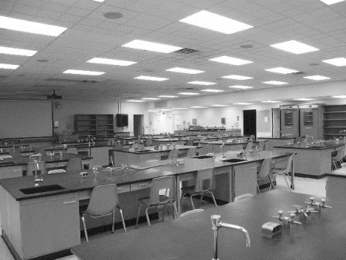
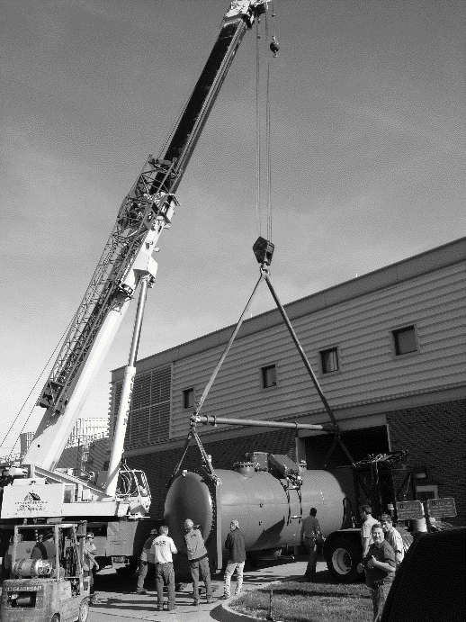
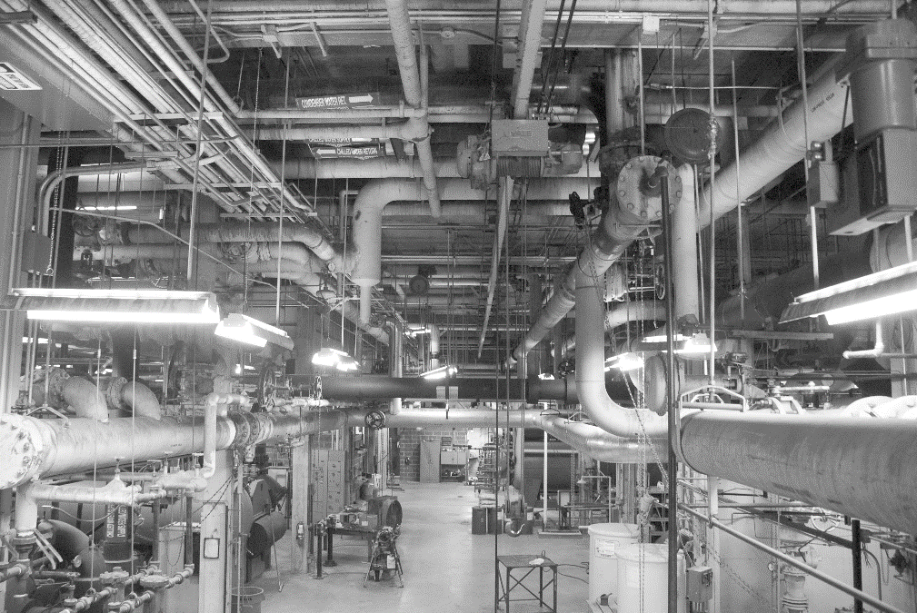
Energy Performance Contracting (EPC)
Program Results
  Annual Dollar Reduction: Approximately $5M
  Total Dollar Reduction to Date: Approximately $18M
  Estimated Deferred Maintenance Backlog Reduction to Date: Approximately $40M
Range of Scope
  AHU Replacement
  New BAS Controls
  Energy Recovery Strategies
  Large Tonnage Chiller Installation
  Roof Replacements
  Clean Room Installation
  Laboratory Controls Installation
  Fume Hood Replacement

Slide 8
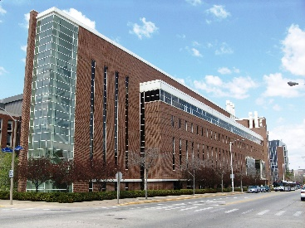
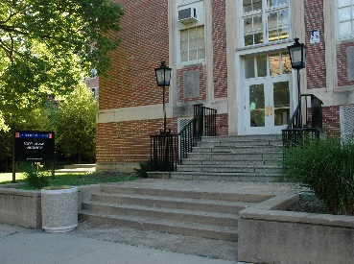
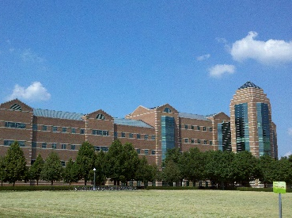
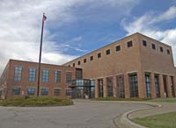
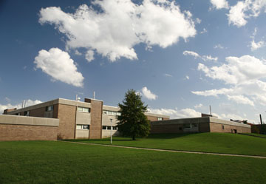
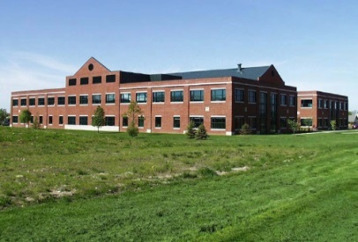
Energy Performance Contracting (EPC)
Laboratory Facilities Project
Chemical & Life Sciences Lab
Roger Adams Lab
Beckman Institute
Illinois Sustainable Technology Center
Natural Resources Studies Annex
Forbes Natural History Building
Project Goals
Reduce Utility Consumption Reduce Deferred Maintenance Less Than 20 Year Payback

Slide 9
U16061 Project Goals
Utility Conservation
Reduction in Deferred Maintenance Backlog
20-year Payback or Less
Schneider Introduction
Selection Process
Contracted for IGA

Slide 10
Schneider Electric Project Experience
Higher Education Market Project Statistics:
$423M in ESCO work
Over $400M in Guaranteed Savings Portfolio
Over $167M in Achieved Savings to Date

Slide 11
Current State
Outdated Lab Facilities
Deferred Maintenance Backlog
Equipment as old as 70 years
Lack of cooling and exhaust capacity
Total Backlog Identified $60M
CLSL $513K Addressed
RAL $23.4M Addressed
High Cost of Operation
High Energy Use
CLSL $8.70/sqft
RAL $7.88/sqft
CLSL 418 kBtu/sq ft
RAL 392 kBtu/sqft
Typical XXX kBtu.sqft (get from CBECS)

Slide 12
Future State
Updated Lab Facilities
Deferred Maintenance Backlog
Best practices for lab operation
Lab capacity met and expanded
$60M
North Matching Funds
Projected Savings
Energy Reduction
CLSL $1.1M per Year
RAL $450K per Year
CLSL XX%
RAL XX%

Slide 13
Construction Phasing Plan
Execute Scope of Work in Blocks:
3 month look-ahead
Target Blocks of 6-8 Labs If Possible
  Coordinated with Department
Installation Duration of 2-3 Weeks in Each Lab Space
Sensitive Equipment Remaining Will Be Protected
  Coordinated with Department and Faculty
Some Labs May Stay Active During Installation

Slide 14
RAL North
Current Conditions
Future Conditions
Multiple Air-Handlers
  Supply/Exhaust Capacity Issues
  Cooling Capacity Issues
Constant Air Volume
Pneumatic Controls
Antiquated Chillers
Original/Historic Windows
Dedicated Outside Air (DOA) Units with New Exhaust
Rework Ductwork
Variable Air Volume
University Standard Air Changes (Occupied/Unoccupied)
Lab Air-Valves
Direct Digital Controls (DDC)
Full Tie-In in to Campus Chilled Water
New Windows
Building Weatherization

Slide 15
RAL North
Construction Expectations
2-3 Week Installation Duration per Lab
Relocate Chemicals
Relocate As Much Lab Equipment as Possible
Ceiling Removal & Installation
Ductwork Removal & Installation
Window Removal & Replacement

Slide 16
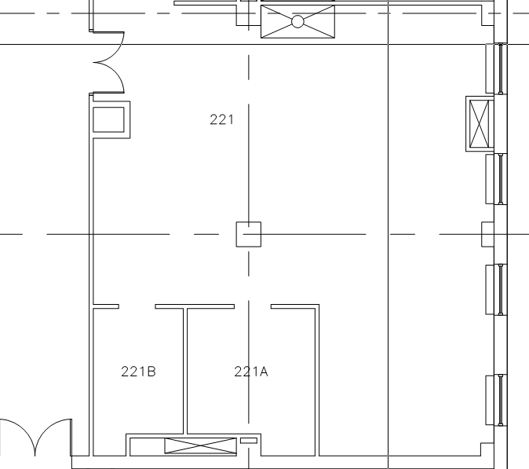
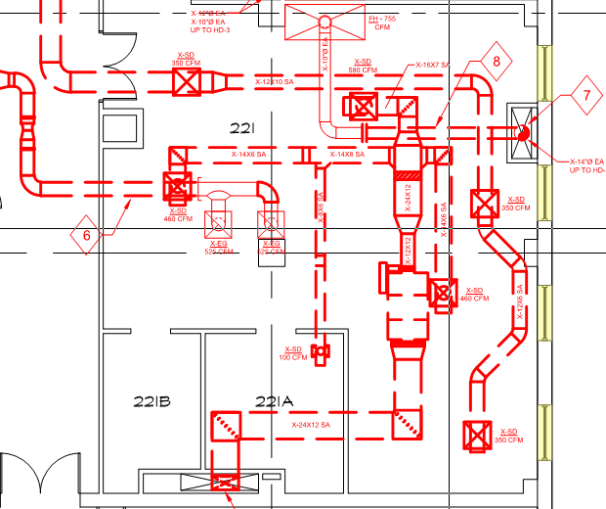
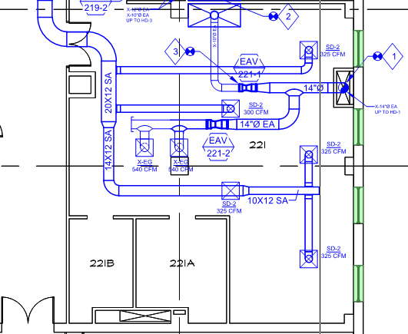
RAL North
Existing
Demo
New

Slide 17
RAL South
Current Conditions
Future Conditions
AHU-S4 Original to Building
  Serves corridors
  Serves office/conference rooms
Pneumatic Controls
High Air-Changes
New AHU-S4
University Standard Air Changes (Occupied/Unoccupied)
Direct Digital Controls (DDC)
Building Weatherization

Slide 18
RAL South
Construction Expectations
Corridors and offices shut down until new air-handler online (X weeks)
Most controls work in corridors
New space temperature sensors - Partial day installation
Most Labs Will Stay Active

Slide 19
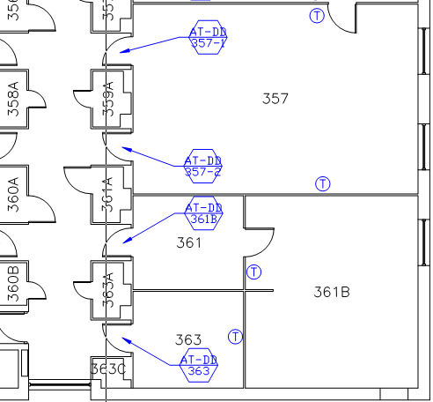
RAL South
New Controls

Slide 20
CLSL Building A
Current Conditions
Future Conditions
Centralized Air-handling
Constant Air Volume
High Air Changes
Standard Air Terminals
Pneumatic Controls
Centralized Air-handling with Modifications to Exhaust
Variable Air Volume
University Standard Air Changes (Occupied/Unoccupied)
Lab Air-Valves
Direct Digital Controls (DDC)
Building Weatherization

Slide 21
CLSL Building A
Construction Expectations
Shutdown of air-handlers for DDC cutover - 0.5-1 Day
Shutdown of fume hood exhaust for modifications - 0.5-1 Day
2-3 Week Duration per Lab
Relocate Chemicals
Relocate As Much Lab Equipment as Possible
Ceiling Removal & Installation
Ductwork Removal & Installation

Slide 22
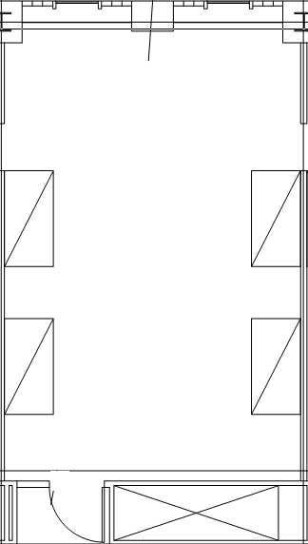
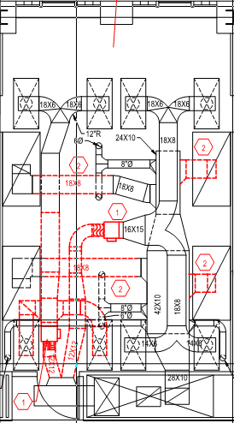
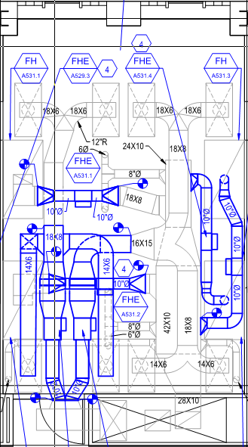
CLSL Building A
Existing
Demo
New

Slide 23
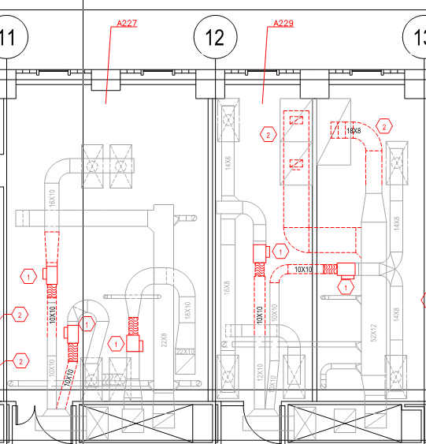
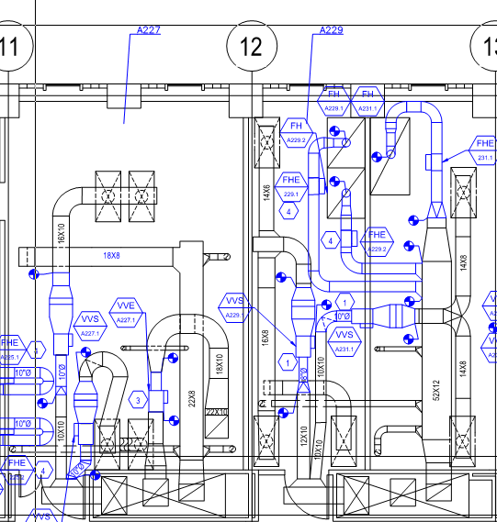
CLSL Building A Laser Labs
Demo
New

Slide 24
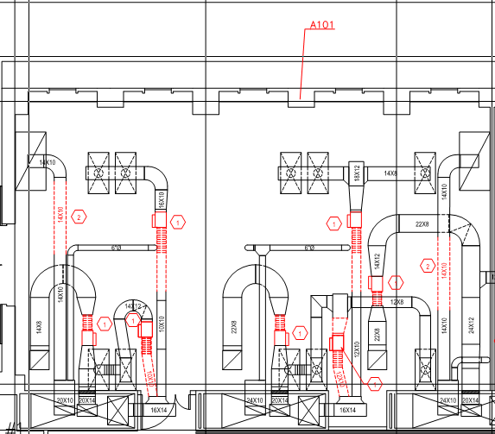
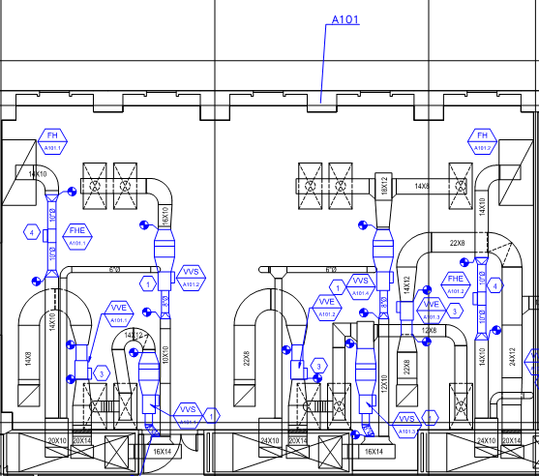
CLSL Building A Laser Labs
Demo
New

Slide 25
CLSL Building B&C
Current Conditions
Future Conditions
Centralized Air-handling
Constant Air Volume
High Air Changes
Standard Air Terminals
Pneumatic Controls
Centralized Air-handling with Modifications to Exhaust
Constant Air Volume
University Standard Air Changes (Occupied/Unoccupied)
Direct Digital Controls (DDC)
Building Weatherization
Why not conversion to VAV and new lab air-valves?

Slide 26
CLSL Building B&C
Construction Expectations
Shutdown of air-handlers for DDC cutover - 0.5-1 Day
Shutdown of fume hood exhaust for modifications - 0.5-1 Day
2-3 Week Duration per Lab Space
Most controls work in Labs
New space temperature sensor installed in each space
Most Labs Will Stay Active

Slide 27
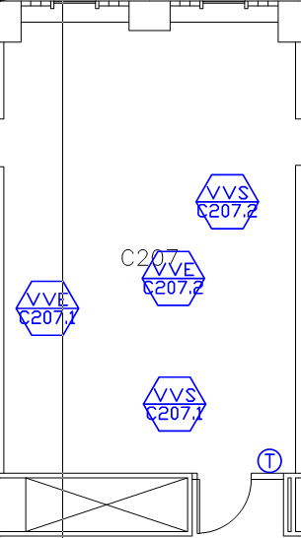
CLSL Building B&C
New Controls

Slide 28
Overall Project Benefits
Summary of Benefits
Guaranteed Energy Savings
Reduced Utility Costs
Reduction in Deferred Maintenance Backlog
Less Than 20 Year Payback
Lab Capacity Expansion
Better Control of Building Comfort Issues
Updated Mechanical Systems & Windows

Slide 29
Communications
Questions & Concerns
All Questions & Concerns Should Be Communicated Through Your Building Representative

Slide 30



